Slide 1
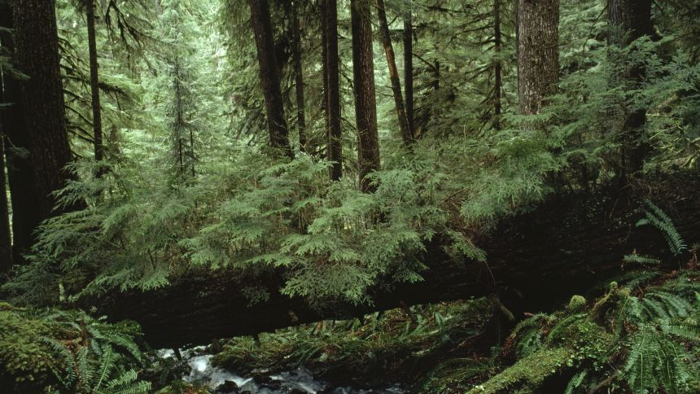


Moral Approach-Avoidance Tendencies as a Measure of Implicit Moral Attitudes
Sanskriti Purohit, Natalie Smith, Kristi Van Meter,
Paul McKee

Slide 2

🧍

Slide 3
🏃
🍔🍟🍩

Slide 4
🏃
🐍

Slide 5
MAAT: Do humans exhibit moral approach-avoidance tendencies (and can they serve as proxies for implicit attitudes)?

Slide 6
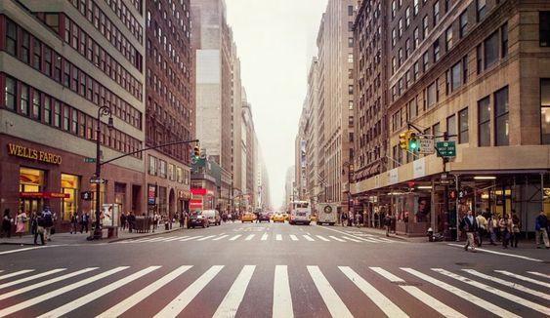
🧍

Slide 7


❓
🏃

Slide 8

❓
🏃

Slide 9
The Approach Avoidance Task (AAT)
Participant determines stimulus color/moral valence (Implicit or Explicit Evaluation)
Participant pushes stimulus away (Avoid)
Participant is shown a stimulus (Phrase or Image)
Participant pulls stimulus closer (Approach)

Slide 10
The Approach Avoidance Task (AAT)
Participant determines stimulus color/moral valence (Implicit or Explicit Evaluation)
Participant pushes stimulus away (Avoid)
Participant is shown a stimulus (Phrase or Image)
Participant pulls stimulus closer (Approach)
Where reaction time is measured

Slide 11
MAAT
Stimuli are either: 3-word Phrases or Images.
Stimuli are two of three Moral Valence categories:
Good and Bad , Good and Neutral, or Neutral and Bad
Stimuli Background Color are either:
Yellow or Blue
Stimuli are Evaluated by either:
Implicit (responding to Background Color) or Explicit (responding to Moral Valence)

Slide 12
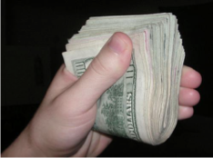
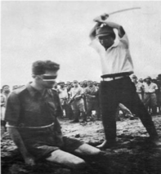
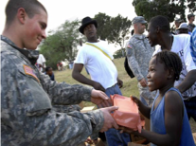
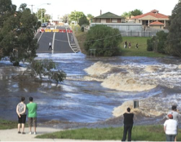
Moral Valence Examples
Morally Good
Example: Saving a life
Morally Neutral
Example: Eating a pizza, Stubbing a toe
Morally Bad
Example: Robbing a store

Slide 13
Moral
Approach Behavior (Implicit/Explicit)

Slide 14
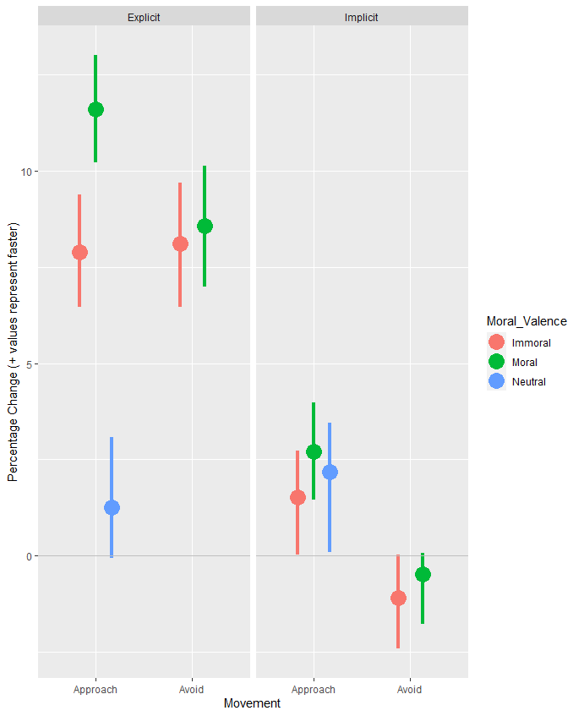
Approaching
Phrases
Notes:
Within Explicit, approaching moral phrases is 4.04% faster than immoral phrases, 95% CI: (2.24%, 5.67%)
Within Explicit, difference in avoiding is not significant.

Slide 15
Approaching
Phrases
Notes:
Within Explicit, approaching moral phrases is 4.04% faster than immoral phrases, 95% CI: (2.24%, 5.67%)
Within Explicit, difference in avoiding is not significant.

Slide 16
Approaching Phrases
Explicit | Approach | Avoid
Moral | 11.61% faster | 8.57% faster
Immoral | 7.89% faster | 8.1% faster
Neutral | 1.26% faster | Point of Reference
Implicit | Approach | Avoid
Moral | 2.70% faster | 0.48% slower
Immoral | 1.53% faster | 1.1% slower
Neutral | 2.18% faster | Point of Reference
Notes:
Within Explicit, approaching moral phrases is 4.04% faster than immoral phrases, 95% CI: (2.24%, 5.67%)
Within Explicit, difference in avoiding is not significant.

Slide 17
Approaching Phrases
Explicit | Approach | Avoid
Moral | 11.61% faster | 8.57% faster
Immoral | 7.89% faster | 8.1% faster
Neutral | 1.26% faster | Point of Reference
Implicit | Approach | Avoid
Moral | 2.70% faster | 0.48% slower
Immoral | 1.53% faster | 1.1% slower
Neutral | 2.18% faster | Point of Reference
Notes:
Within Explicit, approaching moral phrases is 4.04% faster than immoral phrases, 95% CI: (2.24%, 5.67%)
Within Explicit, difference in avoiding is not significant.

Slide 18
Approaching Phrases
Explicit | Approach | Avoid
Moral | 11.61% faster | 8.57% faster
Immoral | 7.89% faster | 8.1% faster
Neutral | 1.26% faster | Point of Reference
Implicit | Approach | Avoid
Moral | 2.70% faster | 0.48% slower
Immoral | 1.53% faster | 1.1% slower
Neutral | 2.18% faster | Point of Reference
Notes:
Within Explicit, approaching moral phrases is 4.04% faster than immoral phrases, 95% CI: (2.24%, 5.67%)
Within Explicit, difference in avoiding is not significant.

Slide 19
Is approaching Moral phrases faster than approaching Immoral phrases?
Explicit | Approach | Avoid
Moral | 11.61% faster | 8.57% faster
Immoral | 7.89% faster | 8.1% faster
Neutral | 1.26% faster | Point of Reference
Implicit | Approach | Avoid
Moral | 2.70% faster | 0.48% slower
Immoral | 1.53% faster | 1.1% slower
Neutral | 2.18% faster | Point of Reference
Approaching Moral phrases is 4.04% faster than approaching Immoral phrases.
95% CI: (2.24%, 5.67%)
Notes:
Within Explicit, approaching moral phrases is 4.04% faster than immoral phrases, 95% CI: (2.24%, 5.67%)
Within Explicit, difference in avoiding is not significant.

Slide 20
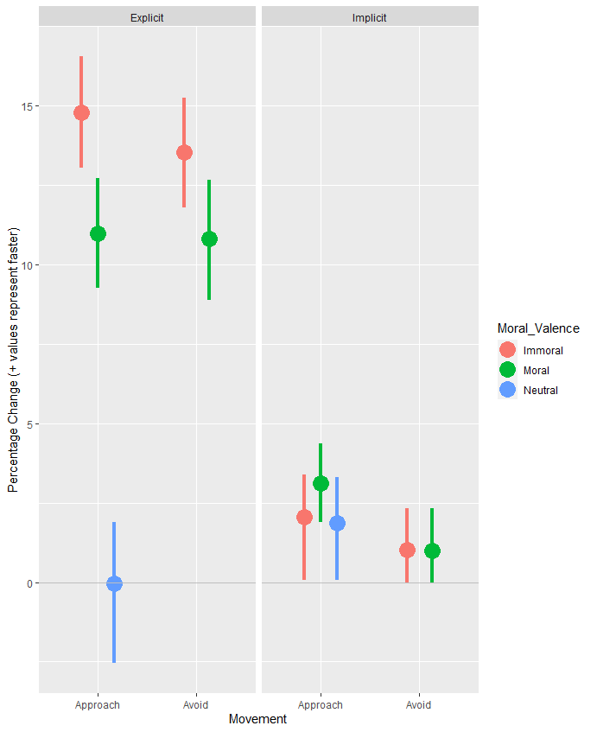
Approaching
Images
Notes:
Within Explicit, approaching immoral photos is 4.46% faster than moral photos, 95% CI: (2.23%, 6.85%)
Within Explicit, Avoiding Immoral Photos is 3.16% faster than avoiding Moral Photos, 95% CI: (1.19%, 5.18%)

Slide 21
Approaching Images
Explicit | Approach | Avoid
Moral | 10.99% faster | 10.81% faster
Immoral | 14.79% faster | 13.54% faster
Neutral | 0.03% slower | Point of Reference
Implicit | Approach | Avoid
Moral | 3.12% faster | 1.00% faster
Immoral | 2.07% faster | 1.03% faster
Neutral | 1.86% faster | Point of Reference
Notes:
Within Explicit, approaching immoral photos is 4.46% faster than moral photos, 95% CI: (2.23%, 6.85%)
Within Explicit, Avoiding Immoral Photos is 3.16% faster than avoiding Moral Photos, 95% CI: (1.19%, 5.18%)

Slide 22
Approaching Images
Explicit | Approach | Avoid
Moral | 10.99% faster | 10.81% faster
Immoral | 14.79% faster | 13.54% faster
Neutral | 0.03% slower | Point of Reference
Implicit | Approach | Avoid
Moral | 3.12% faster | 1.00% faster
Immoral | 2.07% faster | 1.03% faster
Neutral | 1.86% faster | Point of Reference
Notes:
Within Explicit, approaching immoral photos is 4.46% faster than moral photos, 95% CI: (2.23%, 6.85%)
Within Explicit, Avoiding Immoral Photos is 3.16% faster than avoiding Moral Photos, 95% CI: (1.19%, 5.18%)

Slide 23
Approaching Images
Explicit | Approach | Avoid
Moral | 10.99% faster | 10.81% faster
Immoral | 14.79% faster | 13.54% faster
Neutral | 0.03% slower | Point of Reference
Implicit | Approach | Avoid
Moral | 3.12% faster | 1.00% faster
Immoral | 2.07% faster | 1.03% faster
Neutral | 1.86% faster | Point of Reference
Notes:
Within Explicit, approaching immoral photos is 4.46% faster than moral photos, 95% CI: (2.23%, 6.85%)
Within Explicit, Avoiding Immoral Photos is 3.16% faster than avoiding Moral Photos, 95% CI: (1.19%, 5.18%)

Slide 24
Is approaching Moral images faster than approaching Immoral images?
Explicit | Approach | Avoid
Moral | 10.99% faster | 10.81% faster
Immoral | 14.79% faster | 13.54% faster
Neutral | 0.03% slower | Point of Reference
Implicit | Approach | Avoid
Moral | 3.12% faster | 1.00% faster
Immoral | 2.07% faster | 1.03% faster
Neutral | 1.86% faster | Point of Reference
Approaching Moral images is 3.16% slower than approaching Immoral images.
95% CI: (1.19%, 5.18%)
Notes:
Within Explicit, approaching immoral photos is 4.46% faster than moral photos, 95% CI: (2.23%, 6.85%)
Within Explicit, Avoiding Immoral Photos is 3.16% faster than avoiding Moral Photos, 95% CI: (1.19%, 5.18%)

Slide 25
Moral
Avoidance Behavior (Implicit/Explicit)

Slide 26
Avoiding
Phrases
Notes:
Within Explicit, approaching moral phrases is 4.04% faster than immoral phrases, 95% CI: (2.24%, 5.67%)
Within Explicit, difference in avoiding is not significant.

Slide 27
Avoiding Phrases
Explicit | Approach | Avoid
Moral | 11.61% faster | 8.57% faster
Immoral | 7.89% faster | 8.1% faster
Neutral | 1.26% faster | Point of Reference
Implicit | Approach | Avoid
Moral | 2.70% faster | 0.48% slower
Immoral | 1.53% faster | 1.1% slower
Neutral | 2.18% faster | Point of Reference
Notes:
Within Explicit, approaching moral phrases is 4.04% faster than immoral phrases, 95% CI: (2.24%, 5.67%)
Within Explicit, difference in avoiding is not significant.

Slide 28
Avoiding Phrases
Explicit | Approach | Avoid
Moral | 11.61% faster | 8.57% faster
Immoral | 7.89% faster | 8.1% faster
Neutral | 1.26% faster | Point of Reference
Implicit | Approach | Avoid
Moral | 2.70% faster | 0.48% slower
Immoral | 1.53% faster | 1.1% slower
Neutral | 2.18% faster | Point of Reference
Notes:
Within Explicit, approaching moral phrases is 4.04% faster than immoral phrases, 95% CI: (2.24%, 5.67%)
Within Explicit, difference in avoiding is not significant.

Slide 29
Avoiding Phrases
Explicit | Approach | Avoid
Moral | 11.61% faster | 8.57% faster
Immoral | 7.89% faster | 8.1% faster
Neutral | 1.26% faster | Point of Reference
Implicit | Approach | Avoid
Moral | 2.70% faster | 0.48% slower
Immoral | 1.53% faster | 1.1% slower
Neutral | 2.18% faster | Point of Reference
Notes:
Within Explicit, approaching moral phrases is 4.04% faster than immoral phrases, 95% CI: (2.24%, 5.67%)
Within Explicit, difference in avoiding is not significant.

Slide 30
Is avoiding Immoral phrases faster than avoiding Moral phrases?
Explicit | Approach | Avoid
Moral | 11.61% faster | 8.57% faster
Immoral | 7.89% faster | 8.1% faster
Neutral | 1.26% faster | Point of Reference
Implicit | Approach | Avoid
Moral | 2.70% faster | 0.48% slower
Immoral | 1.53% faster | 1.1% slower
Neutral | 2.18% faster | Point of Reference
The difference is not significant.
Notes:
Within Explicit, approaching moral phrases is 4.04% faster than immoral phrases, 95% CI: (2.24%, 5.67%)
Within Explicit, difference in avoiding is not significant.

Slide 31
Avoiding
Images
Notes:
Within Explicit, approaching immoral photos is 4.46% faster than moral photos, 95% CI: (2.23%, 6.85%)
Within Explicit, Avoiding Immoral Photos is 3.16% faster than avoiding Moral Photos, 95% CI: (1.19%, 5.18%)

Slide 32
Avoiding Images
Explicit | Approach | Avoid
Moral | 10.99% faster | 10.81% faster
Immoral | 14.79% faster | 13.54% faster
Neutral | 0.03% slower | Point of Reference
Implicit | Approach | Avoid
Moral | 3.12% faster | 1.00% faster
Immoral | 2.07% faster | 1.03% faster
Neutral | 1.86% faster | Point of Reference
Notes:
Within Explicit, approaching immoral photos is 4.46% faster than moral photos, 95% CI: (2.23%, 6.85%)
Within Explicit, Avoiding Immoral Photos is 3.16% faster than avoiding Moral Photos, 95% CI: (1.19%, 5.18%)

Slide 33
Avoiding Images
Explicit | Approach | Avoid
Moral | 10.99% faster | 10.81% faster
Immoral | 14.79% faster | 13.54% faster
Neutral | 0.03% slower | Point of Reference
Implicit | Approach | Avoid
Moral | 3.12% faster | 1.00% faster
Immoral | 2.07% faster | 1.03% faster
Neutral | 1.86% faster | Point of Reference
Notes:
Within Explicit, approaching immoral photos is 4.46% faster than moral photos, 95% CI: (2.23%, 6.85%)
Within Explicit, Avoiding Immoral Photos is 3.16% faster than avoiding Moral Photos, 95% CI: (1.19%, 5.18%)

Slide 34
Avoiding Images
Explicit | Approach | Avoid
Moral | 10.99% faster | 10.81% faster
Immoral | 14.79% faster | 13.54% faster
Neutral | 0.03% slower | Point of Reference
Implicit | Approach | Avoid
Moral | 3.12% faster | 1.00% faster
Immoral | 2.07% faster | 1.03% faster
Neutral | 1.86% faster | Point of Reference
Notes:
Within Explicit, approaching immoral photos is 4.46% faster than moral photos, 95% CI: (2.23%, 6.85%)
Within Explicit, Avoiding Immoral Photos is 3.16% faster than avoiding Moral Photos, 95% CI: (1.19%, 5.18%)

Slide 35
Is avoiding Immoral images faster than avoiding Moral images?
Explicit | Approach | Avoid
Moral | 10.99% faster | 10.81% faster
Immoral | 14.79% faster | 13.54% faster
Neutral | 0.03% slower | Point of Reference
Implicit | Approach | Avoid
Moral | 3.12% faster | 1.00% faster
Immoral | 2.07% faster | 1.03% faster
Neutral | 1.86% faster | Point of Reference
Avoiding Immoral images 3.16% faster than avoiding Moral images.
95% CI: (1.19%,5.18%)
Notes:
Within Explicit, approaching immoral photos is 4.46% faster than moral photos, 95% CI: (2.23%, 6.85%)
Within Explicit, Avoiding Immoral Photos is 3.16% faster than avoiding Moral Photos, 95% CI: (1.19%, 5.18%)

Slide 36
Moral Behavior Summary
Approach
People approach moral phrases faster than they approach immoral phrases​
​
People approach moral images slower than they approach immoral images*
Avoidance
People avoid immoral images faster than moral images

Slide 37
Is the relationship predictive?
Supervised ML Prediction

Slide 38
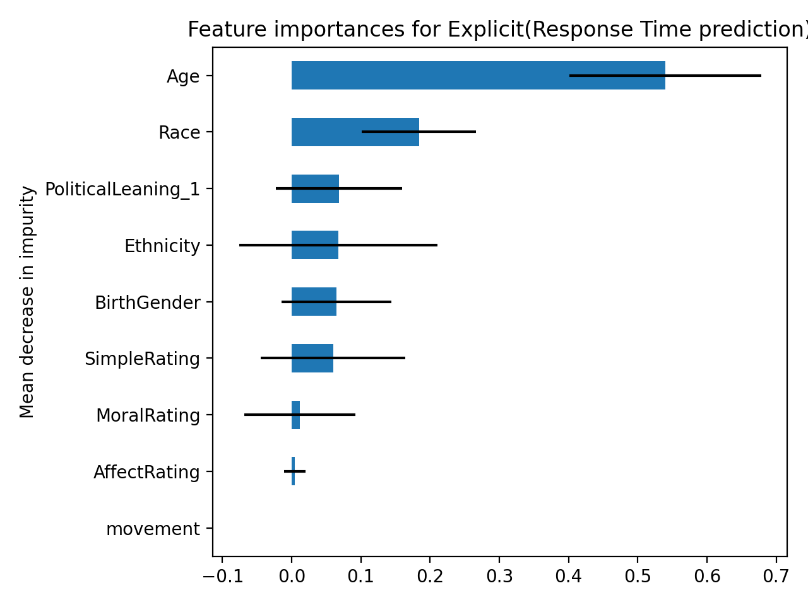
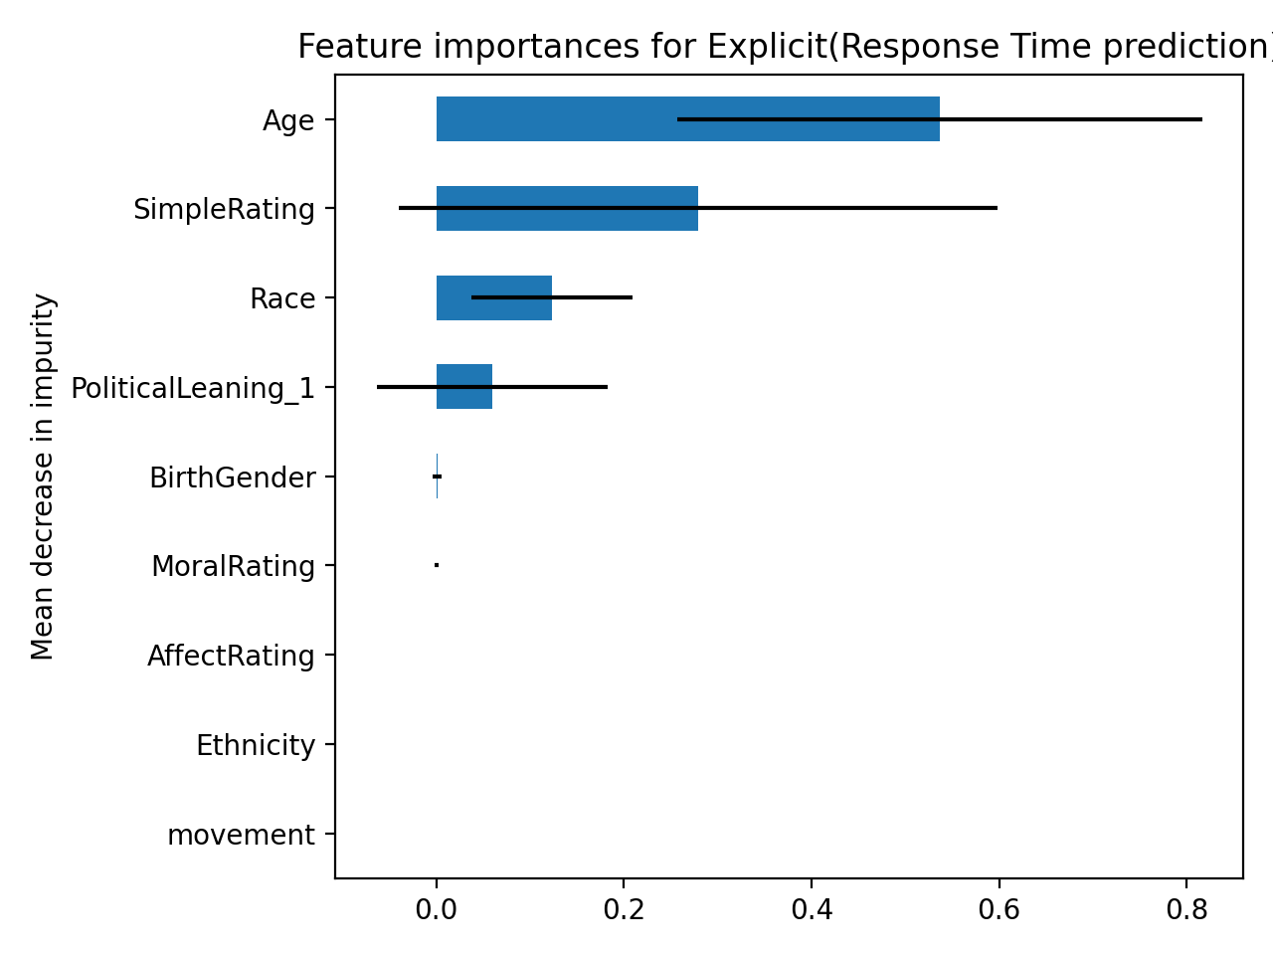
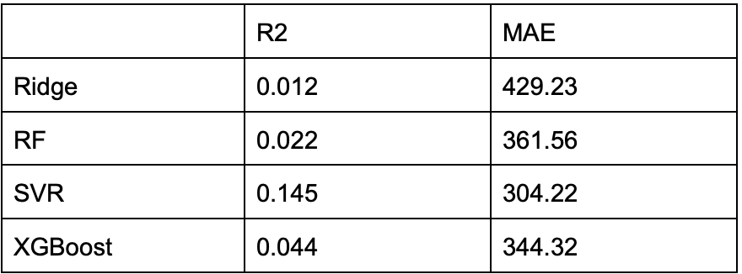
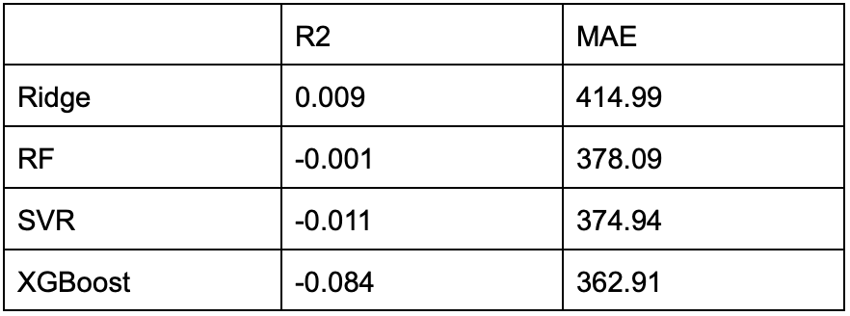
Images
Phrases

Slide 39
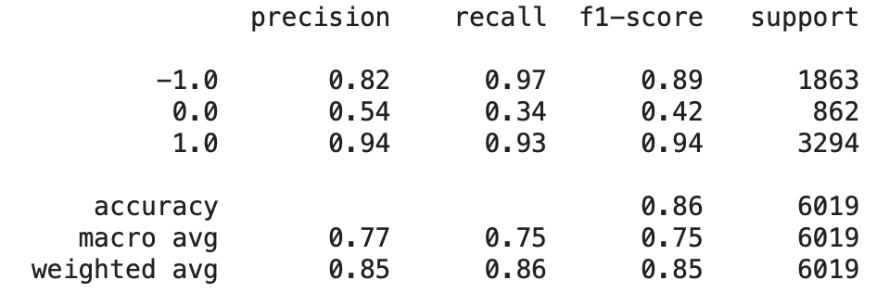
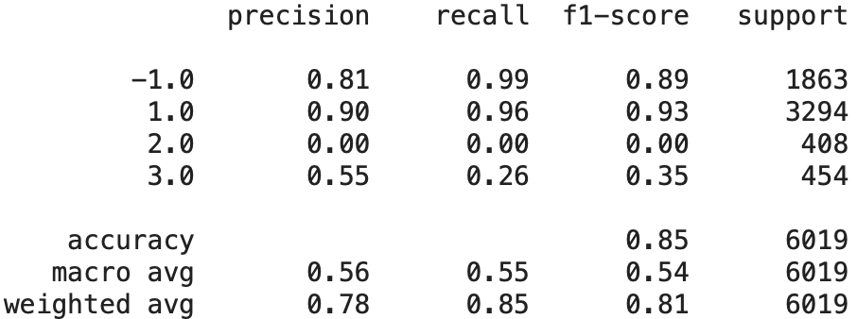
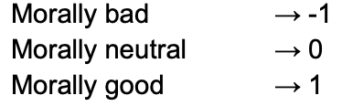
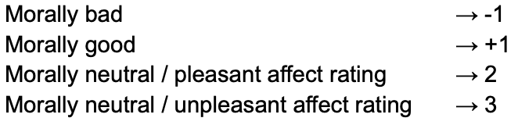
Phrases – Predicting Moral Valence
3-class
4-class
Affect (.69), Simplicity (.28) carry majority of weight
Affect (.70), Simplicity (.27) carry majority of weight

Slide 40
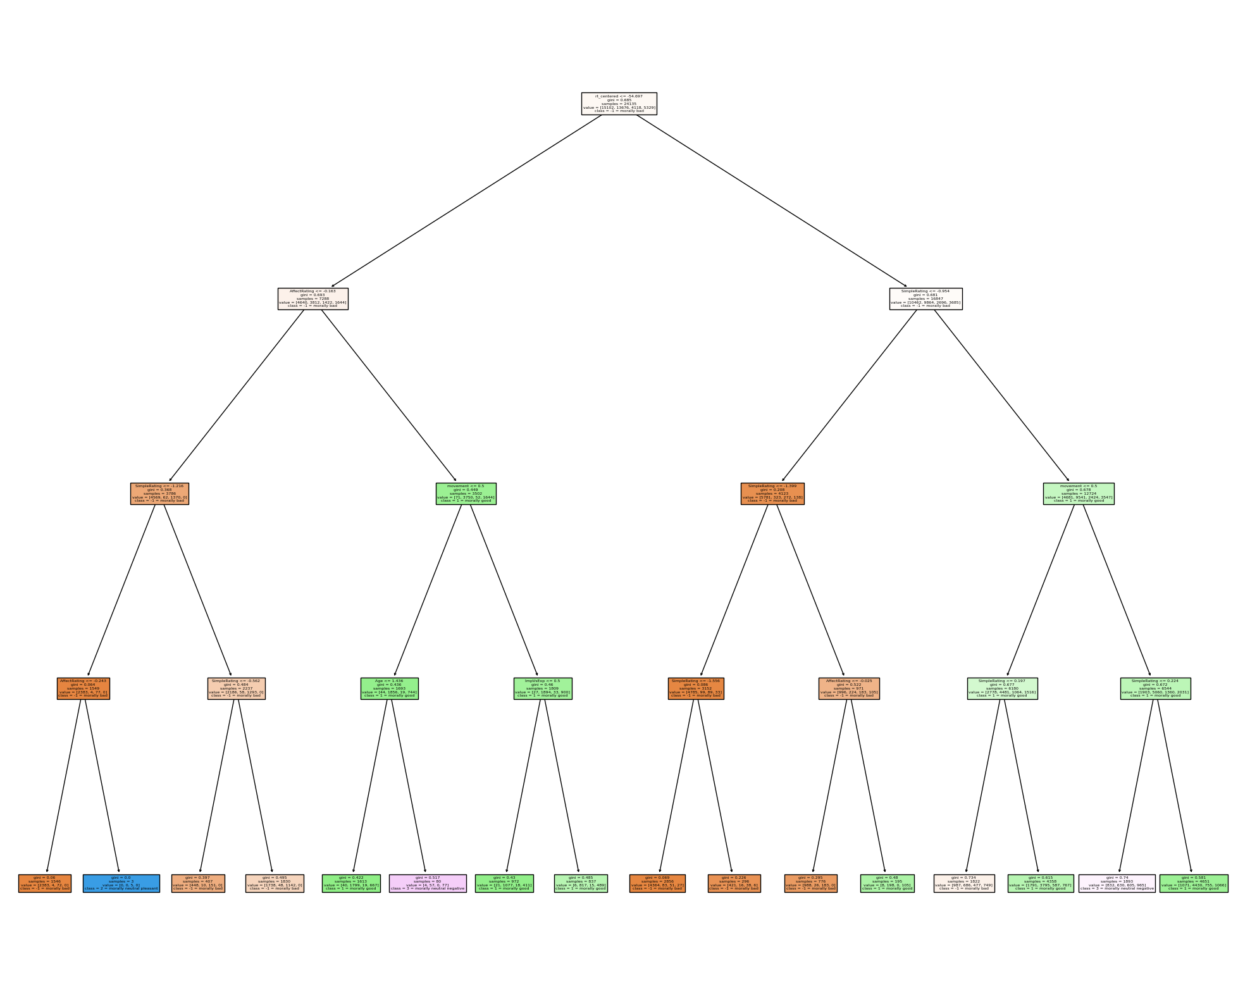
Morally Bad
Morally Good
Morally Neutral, Pleasant
Morally Neutral, Unpleasant
Reaction time
Affect
Simplicity
Simplicity
Movement
Simplicity
Movement

Slide 41
R-MAAT: Does race interact with moral approach avoidance tendencies?

Slide 42
🧍🏾
🧍🏻‍

Slide 43
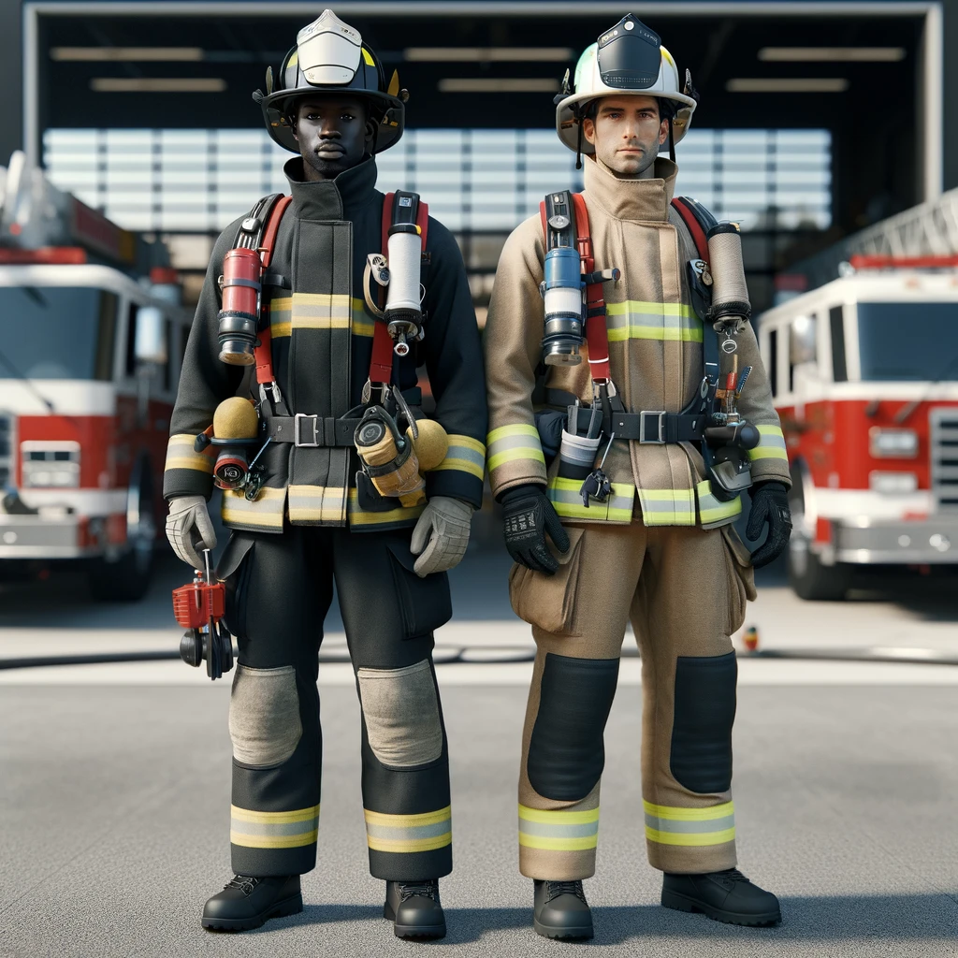
🏃🏿
❓
🏃🏻

Slide 44
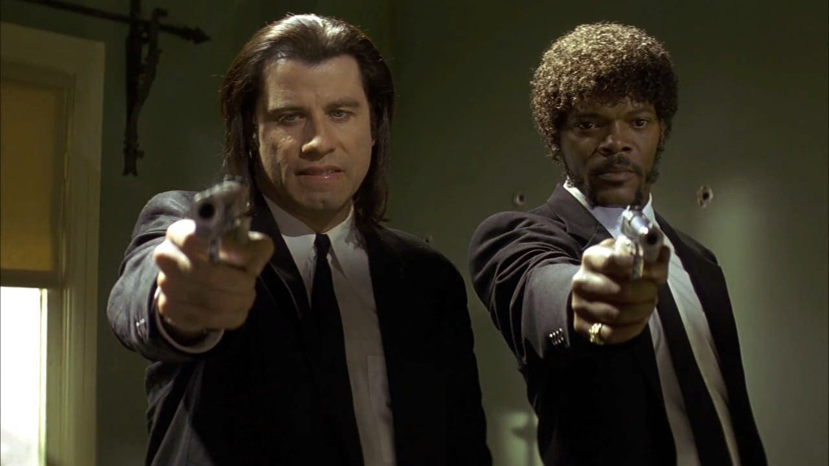
🏃🏿
❓
🏃🏻

Slide 45
R-MAAT: Do humans exhibit racial approach-avoidance tendencies (and can they serve as proxies for implicit attitudes)?

Slide 46
R-MAAT
Stimuli are either: Names or Faces.
Stimuli are both of these Racial Categories categories:
White and Black
Stimuli Dot Color are either:
Red or Blue
Stimuli are Evaluated by either:
Implicit (responding to Dot Color) or Explicit (responding to Racial Category)

Slide 47
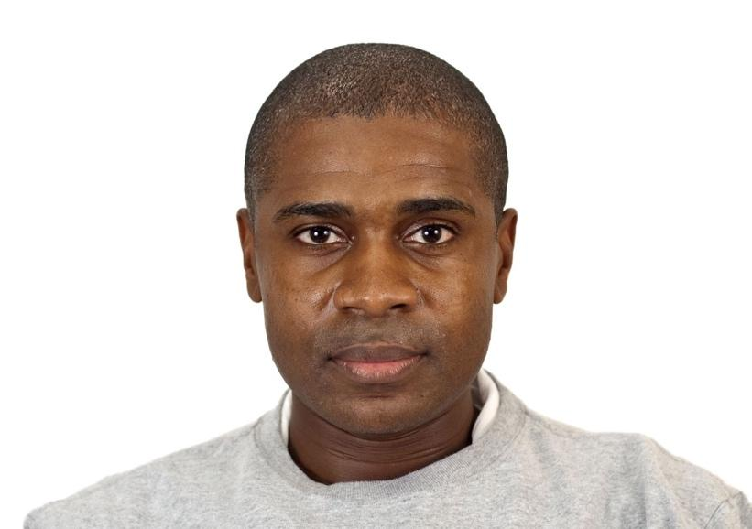
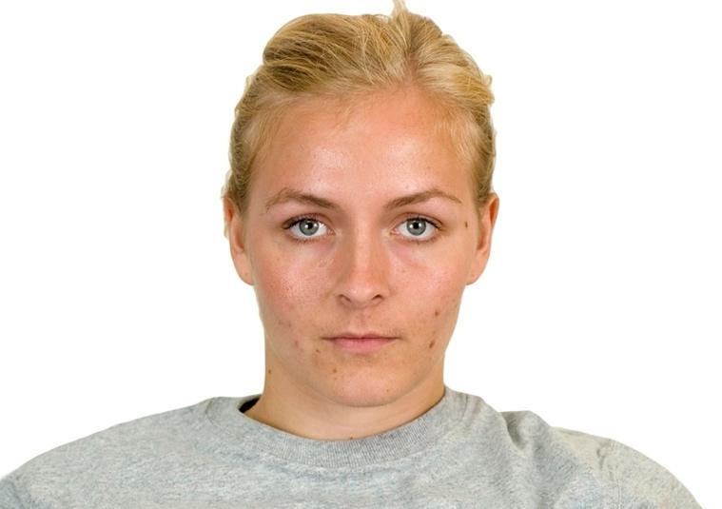
Stimuli Examples
Jermaine
Darnell
Tyrone
Latonya
Tamika
Aisha
Nate
Ethan
Brad
Carly
Katherine
Emma

Slide 48
The Approach Avoidance Task (AAT)
Participant determines stimulus color/race (Implicit or Explicit Evaluation)
Participant pushes stimulus away (Avoid)
Participant is shown a stimulus (Names or Faces)
Participant pulls stimulus closer (Approach)

Slide 49
The Approach Avoidance Task (AAT)
Participant determines stimulus color/race (Implicit or Explicit Evaluation)
Participant pushes stimulus away (Avoid)
Participant is shown a stimulus (Names or Faces)
Participant pulls stimulus closer (Approach)
Where reaction time is measured

Slide 50
Racial
Approach Behavior

Slide 51
Approaching Names
 | White Participants | Black Participants
Approach White Names | 17.23% faster | 1.62% slower
Approach Black Names | 16.02% faster | 13.58% faster
Avoid White Names | 16.28% faster | 8.52% faster
Avoid Black Names | 13.54% faster | Point of Reference
 | White Participants | Black Participants
Approach White Faces | 10.58% faster | 1.40% faster
Approach Black Faces | 2.36% faster | 1.23 % slower
Avoid White Faces | 1.99% faster | 3.62 % slower
Avoid Black Faces | 8.62% faster | Point of Reference

Slide 52
White participants approaching white names
 | White Participants | Black Participants
Approach White Names | 17.23% faster | 1.62% slower
Approach Black Names | 16.02% faster | 13.58% faster
Avoid White Names | 16.28% faster | 8.52% faster
Avoid Black Names | 13.54% faster | Point of Reference
 | White Participants | Black Participants
Approach White Faces | 10.58% faster | 1.40% faster
Approach Black Faces | 2.36% faster | 1.23 % slower
Avoid White Faces | 1.99% faster | 3.62 % slower
Avoid Black Faces | 8.62% faster | Point of Reference

Slide 53
White participants approaching black names
 | White Participants | Black Participants
Approach White Names | 17.23% faster | 1.62% slower
Approach Black Names | 16.02% faster | 13.58% faster
Avoid White Names | 16.28% faster | 8.52% faster
Avoid Black Names | 13.54% faster | Point of Reference
 | White Participants | Black Participants
Approach White Faces | 10.58% faster | 1.40% faster
Approach Black Faces | 2.36% faster | 1.23 % slower
Avoid White Faces | 1.99% faster | 3.62 % slower
Avoid Black Faces | 8.62% faster | Point of Reference

Slide 54
Do white people approach white names faster than black names?
 | White Participants | Black Participants
Approach White Names | 17.23% faster | 1.62% slower
Approach Black Names | 16.02% faster | 13.58% faster
Avoid White Names | 16.28% faster | 8.52% faster
Avoid Black Names | 13.54% faster | Point of Reference
 | White Participants | Black Participants
Approach White Faces | 10.58% faster | 1.40% faster
Approach Black Faces | 2.36% faster | 1.23 % slower
Avoid White Faces | 1.99% faster | 3.62 % slower
Avoid Black Faces | 8.62% faster | Point of Reference
Not a Significant Difference.

Slide 55
Black participants approaching white names
 | White Participants | Black Participants
Approach White Names | 17.23% faster | 1.62% slower
Approach Black Names | 16.02% faster | 13.58% faster
Avoid White Names | 16.28% faster | 8.52% faster
Avoid Black Names | 13.54% faster | Point of Reference
 | White Participants | Black Participants
Approach White Faces | 10.58% faster | 1.40% faster
Approach Black Faces | 2.36% faster | 1.23 % slower
Avoid White Faces | 1.99% faster | 3.62 % slower
Avoid Black Faces | 8.62% faster | Point of Reference

Slide 56
Black participants approaching black names
 | White Participants | Black Participants
Approach White Names | 17.23% faster | 1.62% slower
Approach Black Names | 16.02% faster | 13.58% faster
Avoid White Names | 16.28% faster | 8.52% faster
Avoid Black Names | 13.54% faster | Point of Reference
 | White Participants | Black Participants
Approach White Faces | 10.58% faster | 1.40% faster
Approach Black Faces | 2.36% faster | 1.23 % slower
Avoid White Faces | 1.99% faster | 3.62 % slower
Avoid Black Faces | 8.62% faster | Point of Reference

Slide 57
Do black people approach black names faster than white names?
 | White Participants | Black Participants
Approach White Names | 17.23% faster | 1.62% slower
Approach Black Names | 16.02% faster | 13.58% faster
Avoid White Names | 16.28% faster | 8.52% faster
Avoid Black Names | 13.54% faster | Point of Reference
 | White Participants | Black Participants
Approach White Faces | 10.58% faster | 1.40% faster
Approach Black Faces | 2.36% faster | 1.23 % slower
Avoid White Faces | 1.99% faster | 3.62 % slower
Avoid Black Faces | 8.62% faster | Point of Reference
Black People approach Black Names 14.78% faster than White Names.
95% CI: (11.69%,18.15%)

Slide 58
Approaching Faces
 | White Participants | Black Participants
Approach White Names | 17.23% faster | 1.62% slower
Approach Black Names | 16.02% faster | 13.58% faster
Avoid White Names | 16.28% faster | 8.52% faster
Avoid Black Names | 13.54% faster | Point of Reference
 | White Participants | Black Participants
Approach White Faces | 10.58% faster | 1.40% faster
Approach Black Faces | 2.36% faster | 1.23 % slower
Avoid White Faces | 1.99% faster | 3.62 % slower
Avoid Black Faces | 8.62% faster | Point of Reference

Slide 59
White participants approaching white faces
 | White Participants | Black Participants
Approach White Names | 17.23% faster | 1.62% slower
Approach Black Names | 16.02% faster | 13.58% faster
Avoid White Names | 16.28% faster | 8.52% faster
Avoid Black Names | 13.54% faster | Point of Reference
 | White Participants | Black Participants
Approach White Faces | 10.58% faster | 1.40% faster
Approach Black Faces | 2.36% faster | 1.23 % slower
Avoid White Faces | 1.99% faster | 3.62 % slower
Avoid Black Faces | 8.62% faster | Point of Reference

Slide 60
White participants approaching black faces
 | White Participants | Black Participants
Approach White Names | 17.23% faster | 1.62% slower
Approach Black Names | 16.02% faster | 13.58% faster
Avoid White Names | 16.28% faster | 8.52% faster
Avoid Black Names | 13.54% faster | Point of Reference
 | White Participants | Black Participants
Approach White Faces | 10.58% faster | 1.40% faster
Approach Black Faces | 2.36% faster | 1.23 % slower
Avoid White Faces | 1.99% faster | 3.62 % slower
Avoid Black Faces | 8.62% faster | Point of Reference

Slide 61
Do white people approach white faces faster than black faces?
 | White Participants | Black Participants
Approach White Names | 17.23% faster | 1.62% slower
Approach Black Names | 16.02% faster | 13.58% faster
Avoid White Names | 16.28% faster | 8.52% faster
Avoid Black Names | 13.54% faster | Point of Reference
 | White Participants | Black Participants
Approach White Faces | 10.58% faster | 1.40% faster
Approach Black Faces | 2.36% faster | 1.23 % slower
Avoid White Faces | 1.99% faster | 3.62 % slower
Avoid Black Faces | 8.62% faster | Point of Reference
White People approach White Faces 8.42% faster than Black Faces.
95% CI: (6.41%,10.35%)

Slide 62
Racial
Avoidance Behavior

Slide 63
Avoiding Names
 | White Participants | Black Participants
Approach White Names | 17.23% faster | 1.62% slower
Approach Black Names | 16.02% faster | 13.58% faster
Avoid White Names | 16.28% faster | 8.52% faster
Avoid Black Names | 13.54% faster | Point of Reference
 | White Participants | Black Participants
Approach White Faces | 10.58% faster | 1.40% faster
Approach Black Faces | 2.36% faster | 1.23 % slower
Avoid White Faces | 1.99% faster | 3.62 % slower
Avoid Black Faces | 8.62% faster | Point of Reference

Slide 64
White participants avoiding white names
 | White Participants | Black Participants
Approach White Names | 17.23% faster | 1.62% slower
Approach Black Names | 16.02% faster | 13.58% faster
Avoid White Names | 16.28% faster | 8.52% faster
Avoid Black Names | 13.54% faster | Point of Reference
 | White Participants | Black Participants
Approach White Faces | 10.58% faster | 1.40% faster
Approach Black Faces | 2.36% faster | 1.23 % slower
Avoid White Faces | 1.99% faster | 3.62 % slower
Avoid Black Faces | 8.62% faster | Point of Reference

Slide 65
White participants avoiding black names
 | White Participants | Black Participants
Approach White Names | 17.23% faster | 1.62% slower
Approach Black Names | 16.02% faster | 13.58% faster
Avoid White Names | 16.28% faster | 8.52% faster
Avoid Black Names | 13.54% faster | Point of Reference
 | White Participants | Black Participants
Approach White Faces | 10.58% faster | 1.40% faster
Approach Black Faces | 2.36% faster | 1.23 % slower
Avoid White Faces | 1.99% faster | 3.62 % slower
Avoid Black Faces | 8.62% faster | Point of Reference

Slide 66
Do white people avoid black names faster than white names?
 | White Participants | Black Participants
Approach White Names | 17.23% faster | 1.62% slower
Approach Black Names | 16.02% faster | 13.58% faster
Avoid White Names | 16.28% faster | 8.52% faster
Avoid Black Names | 13.54% faster | Point of Reference
 | White Participants | Black Participants
Approach White Faces | 10.58% faster | 1.40% faster
Approach Black Faces | 2.36% faster | 1.23 % slower
Avoid White Faces | 1.99% faster | 3.62 % slower
Avoid Black Faces | 8.62% faster | Point of Reference
White People avoid White Names 3.23% faster than Black Names.
95% CI: (0.079%,5.57%)

Slide 67
Avoiding Faces
 | White Participants | Black Participants
Approach White Names | 17.23% faster | 1.62% slower
Approach Black Names | 16.02% faster | 13.58% faster
Avoid White Names | 16.28% faster | 8.52% faster
Avoid Black Names | 13.54% faster | Point of Reference
 | White Participants | Black Participants
Approach White Faces | 10.58% faster | 1.40% faster
Approach Black Faces | 2.36% faster | 1.23 % slower
Avoid White Faces | 1.99% faster | 3.62 % slower
Avoid Black Faces | 8.62% faster | Point of Reference

Slide 68
White participants avoiding white faces
 | White Participants | Black Participants
Approach White Names | 17.23% faster | 1.62% slower
Approach Black Names | 16.02% faster | 13.58% faster
Avoid White Names | 16.28% faster | 8.52% faster
Avoid Black Names | 13.54% faster | Point of Reference
 | White Participants | Black Participants
Approach White Faces | 10.58% faster | 1.40% faster
Approach Black Faces | 2.36% faster | 1.23 % slower
Avoid White Faces | 1.99% faster | 3.62 % slower
Avoid Black Faces | 8.62% faster | Point of Reference

Slide 69
White participants avoiding black faces
 | White Participants | Black Participants
Approach White Names | 17.23% faster | 1.62% slower
Approach Black Names | 16.02% faster | 13.58% faster
Avoid White Names | 16.28% faster | 8.52% faster
Avoid Black Names | 13.54% faster | Point of Reference
 | White Participants | Black Participants
Approach White Faces | 10.58% faster | 1.40% faster
Approach Black Faces | 2.36% faster | 1.23 % slower
Avoid White Faces | 1.99% faster | 3.62 % slower
Avoid Black Faces | 8.62% faster | Point of Reference

Slide 70
Do white people avoid black faces faster than white faces?
 | White Participants | Black Participants
Approach White Names | 17.23% faster | 1.62% slower
Approach Black Names | 16.02% faster | 13.58% faster
Avoid White Names | 16.28% faster | 8.52% faster
Avoid Black Names | 13.54% faster | Point of Reference
 | White Participants | Black Participants
Approach White Faces | 10.58% faster | 1.40% faster
Approach Black Faces | 2.36% faster | 1.23 % slower
Avoid White Faces | 1.99% faster | 3.62 % slower
Avoid Black Faces | 8.62% faster | Point of Reference
White People avoid Black Faces 7.28% faster than White Faces.
95% CI: (5.00%,9.64%)

Slide 71
Racial Behavior Summary
Black People Approach Black Names faster than White Names​
​
White People Approach White Faces faster than Black Faces​
White People Avoid White Names faster than Black Names​​
​​
White People Avoid Black Faces faster than White Faces

Slide 72
Is the relationship predictive?
Supervised ML Prediction

Slide 73
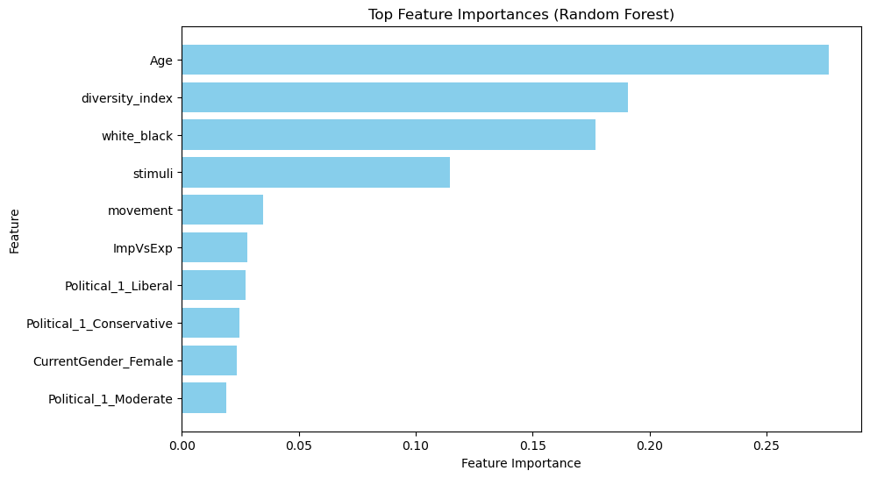
Predicting response time based on racial exposure: faces
 | R-Squared | MSE
SVR | -0.097 | 152048.71
Random Forest | 0.147 | 118168.37
XGBoost | 0.011 | 137120.27

Slide 74
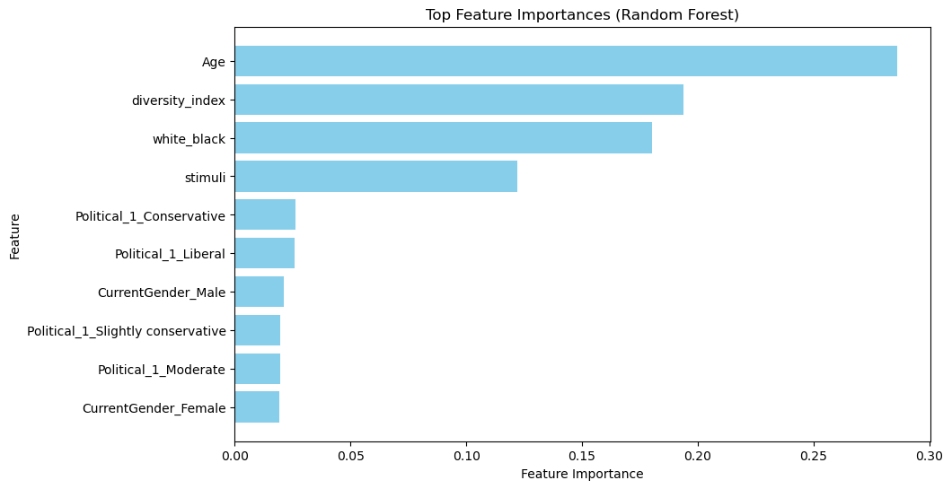
Predicting response time based on racial exposure: names
 | R-Squared | MSE
SVR | -0.097 | 152044.44
Random Forest | 0.109 | 123540.17
XGBoost | -0.093 | 151560.25

Slide 75
Conclusions
Moral
Racial
Do humans exhibit moral approach-avoidance tendencies? Yes!
People approach moral phrases faster than immoral phrases
People avoid immoral images faster than moral images
People approach moral images slower than they approach immoral images*
Do humans exhibit racial approach-avoidance tendencies?​ Yes!
Black people approach black names faster than white names
White people approach white faces faster than black faces
White people avoid white faces slower than black faces
White people avoid white names faster than black names*

Slide 76
Thank you for your time and interest.
Any questions?

Slide 77
Appendix

Slide 78

Linear Mixed Effects Models
🧍‍♂️

Slide 79

Linear Mixed Effects Models
👴
👨

Slide 80
Linear Mixed Effects Models
🏃‍♂️
🍟

Slide 81
Linear Mixed Effects Models
🏃‍♂️
🐍

Slide 82
LINEAR MODELS
Outcome = E(Outcome) + AX + BY + Error

Slide 83
Linear Mixed Effects Models
🧍🏽‍♀️
🧍🏼
🧍🏻‍♀️
🧍🏾

Slide 84
Linear Mixed Effects Models
🧍🏽‍♀️
🧍🏼
❌
🧍🏻‍♀️
🧍🏾

Slide 85
Linear Mixed Effects Models
🧍🏽‍♀️
🧍🏽‍♀️
🧍🏽‍♀️
🧍🏽‍♀️
🧍🏽‍♀️
🧍🏼
🧍🏼
🧍🏼
🧍🏼
❌
🧍🏼
🧍🏻‍♀️
🧍🏻‍♀️
🧍🏻‍♀️
🧍🏻‍♀️
🧍🏻‍♀️
🧍🏾
🧍🏾
🧍🏾
🧍🏾
🧍🏾

Slide 86
Linear Mixed Effects Models
🧍🏽‍♀️
✔️
🧍🏽‍♀️
🧍🏽‍♀️
🧍🏽‍♀️
🧍🏽‍♀️
🧍🏼
🧍🏼
🧍🏼
🧍🏼
❌
🧍🏼
🧍🏻‍♀️
🧍🏻‍♀️
🧍🏻‍♀️
🧍🏻‍♀️
🧍🏻‍♀️
🧍🏾
🧍🏾
🧍🏾
🧍🏾
🧍🏾

Slide 87
Linear Mixed Effects Models
E( )

Slide 88
Linear Mixed Effects Models
🧍🏼
E( ) +

Slide 89
Linear Mixed Effects Models
🧍🏼
E( ) +
🧍🏾
E( ) +

Slide 90
LINEAR MIXED EFFECTS MODELS
Outcome_{i} = E(Outcome)_{i} + AX + BY + Error

Slide 91
LINEAR MODELS
Outcome_{i} = E(Outcome)_{i} + AX + BY + Error
🧍🏼
E(Outcome)_{i} = E(Outcome) +
i

Slide 92
MODEL RESULTS

Slide 93
Linear Mixed Effects Models: Implicit (Phrases)
Birth Gender
Age
Race
Movement
Moral Valence
Fixed Effects
Intercept: Participant
Random Effects
Notes:
Explain random effect choices

Slide 94
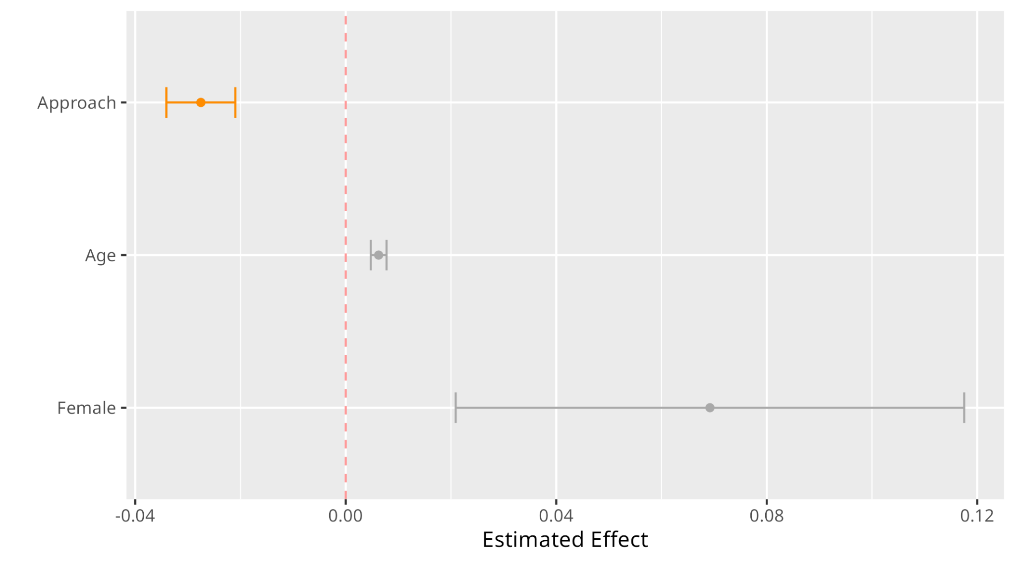
Approaching is faster than avoiding by approximately 3%
Notes:
Estimated effect relates to change in response time on the log scale

Slide 95
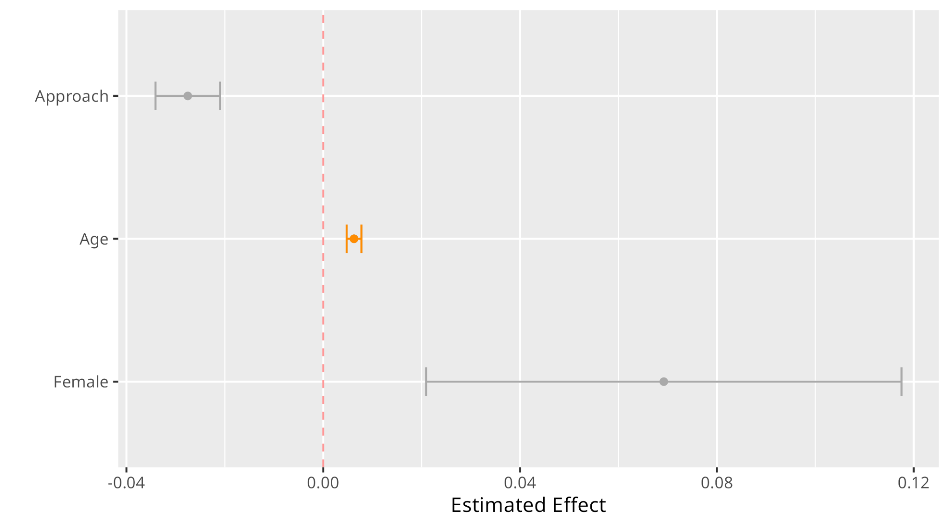
Notes:
Like here i will say “age generally slows response time, and…” and thats it (turn over)

Slide 96
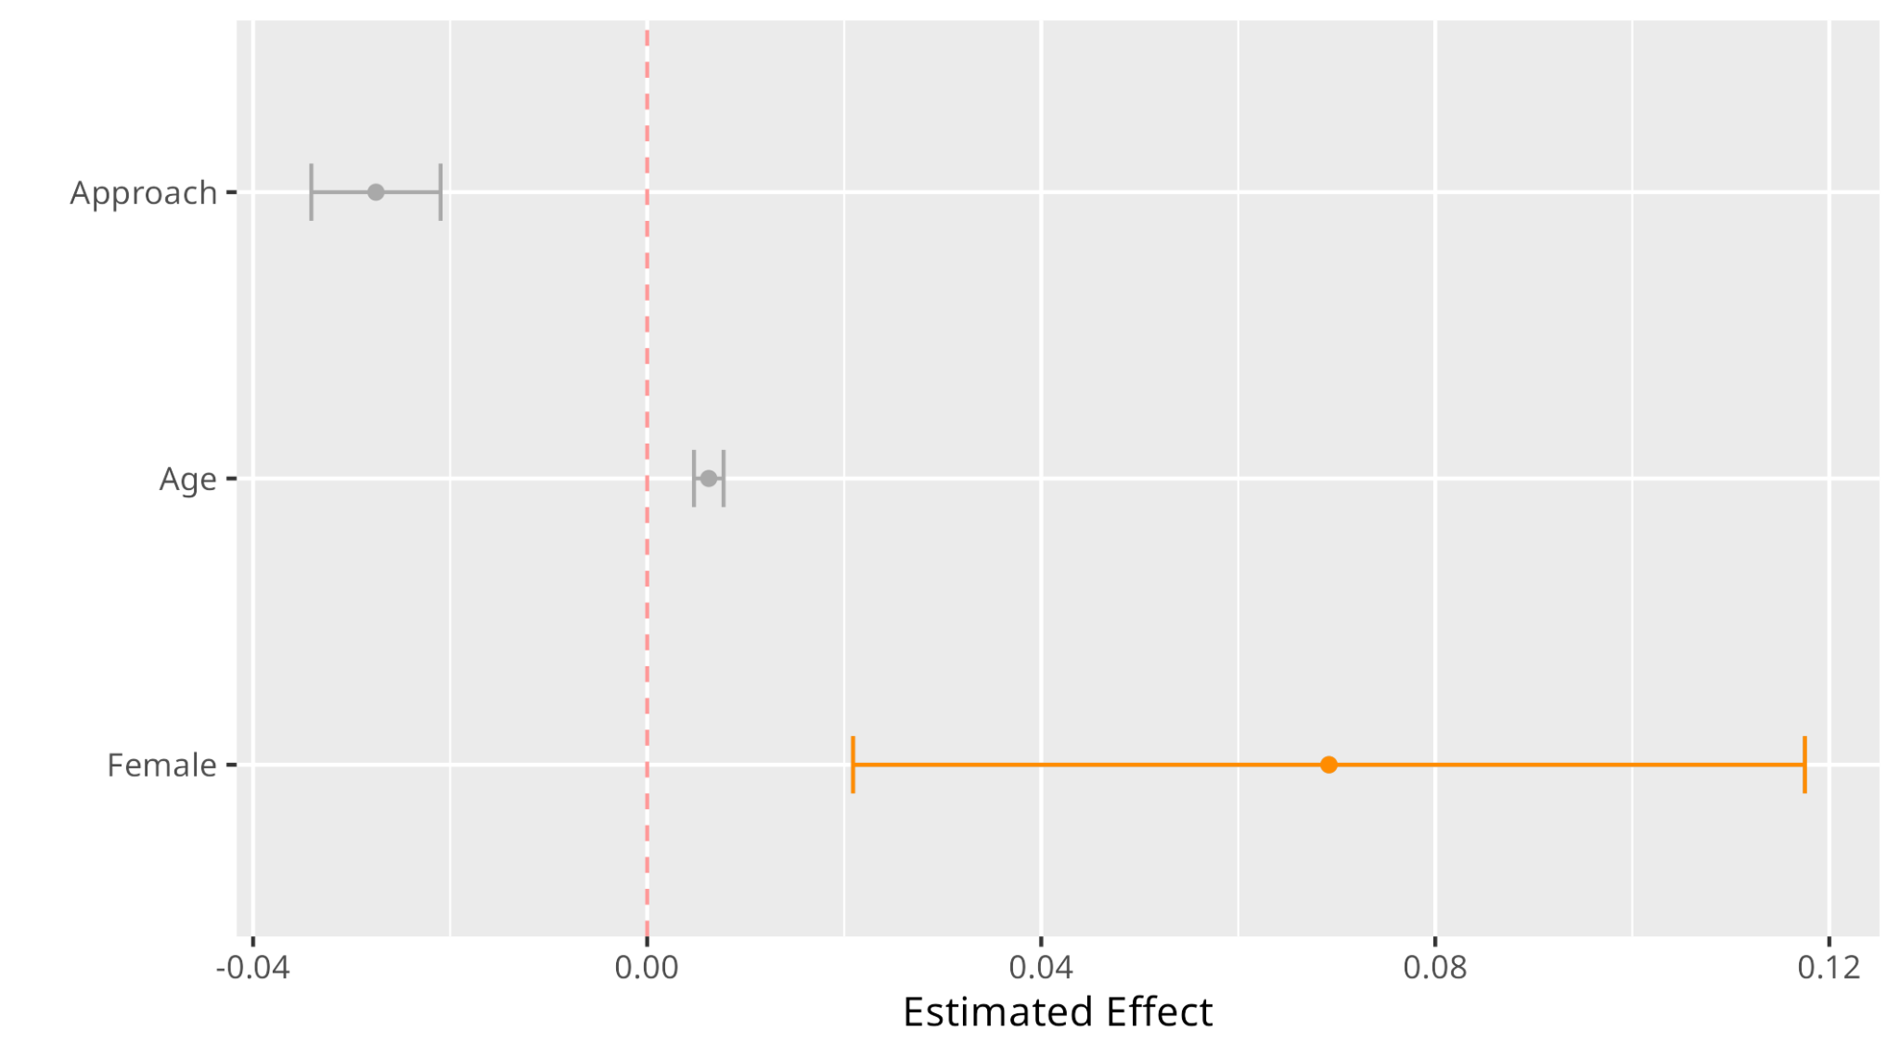

Slide 97
Linear Mixed Effects Models: Explicit (Phrases)
Birth Gender
Age
Race
Movement
Moral Valence
Affect Rating
Fixed Effects
Intercept: Participant
Slope: Moral Valence
Random Effects
Notes:
Explain random effect choices

Slide 98
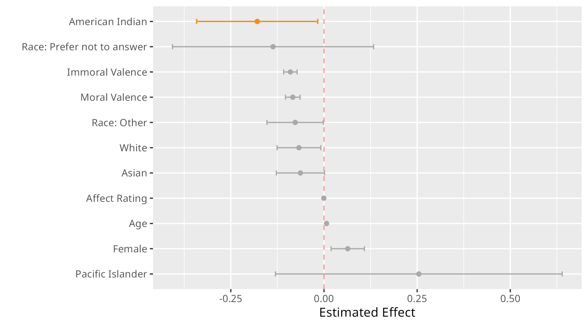
Notes:
Baseline: Black, Neutral Valence, Male

Slide 99
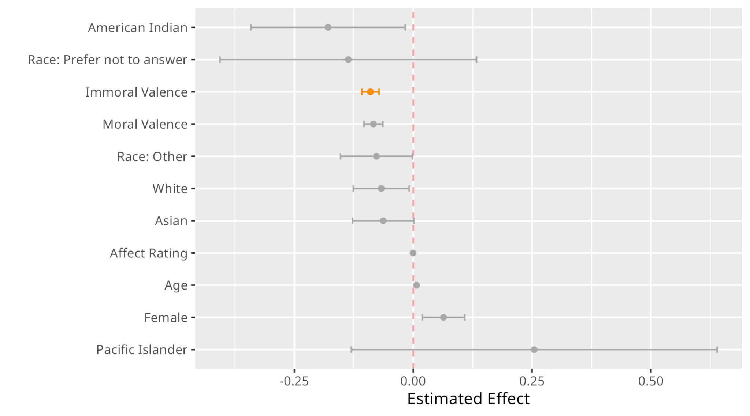
On average, compared to Neutral-rated phrases, responses to Immoral-rated phrases are faster by 8.6%.

Slide 100
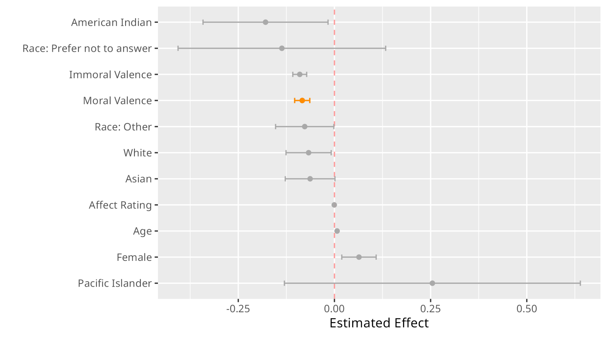
On average, compared to Neutral-rated phrases, responses to Moral-rated phrases are faster by 7.6%.

Slide 101
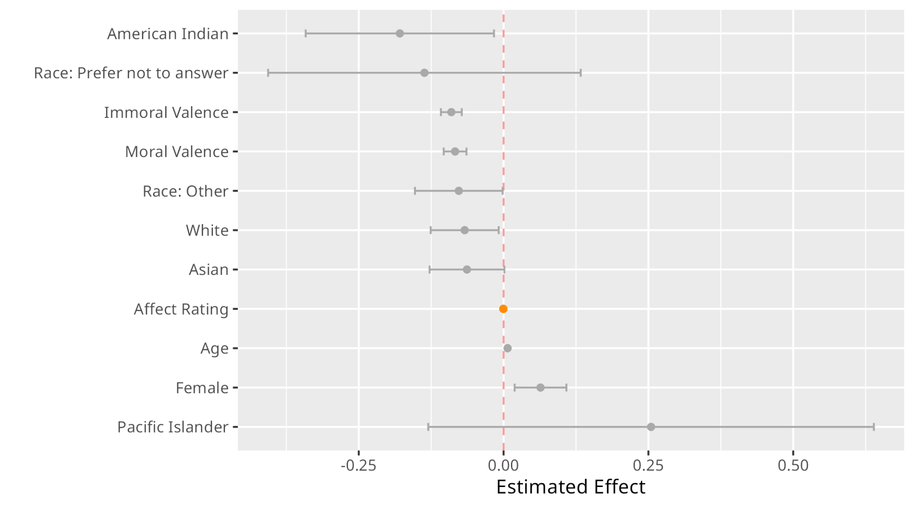
With 1 unit slower in Affect Rating, there is a 1 millisecond slower in the response time.
Notes:
Baseline: Black, Neutral Valence, Male

Slide 102
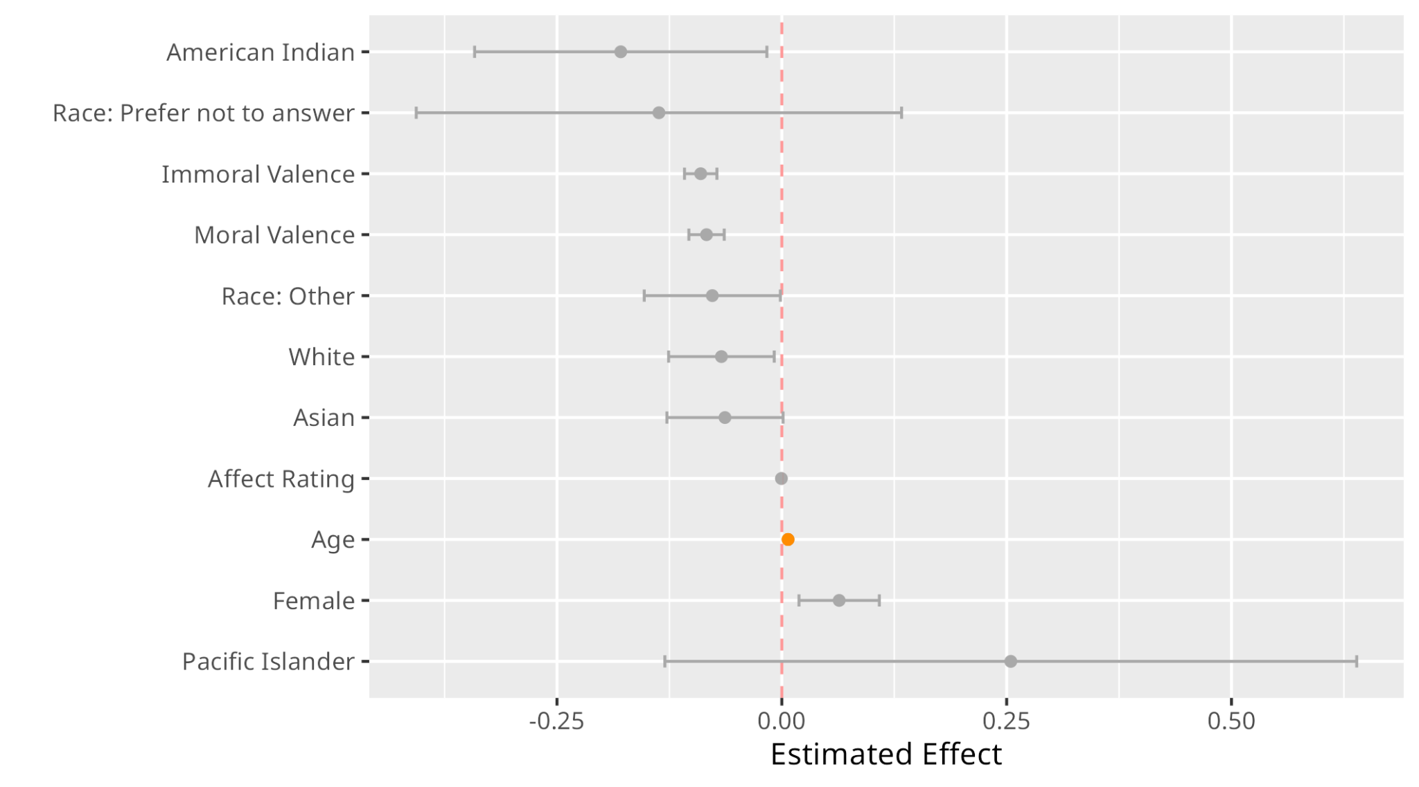

Slide 103
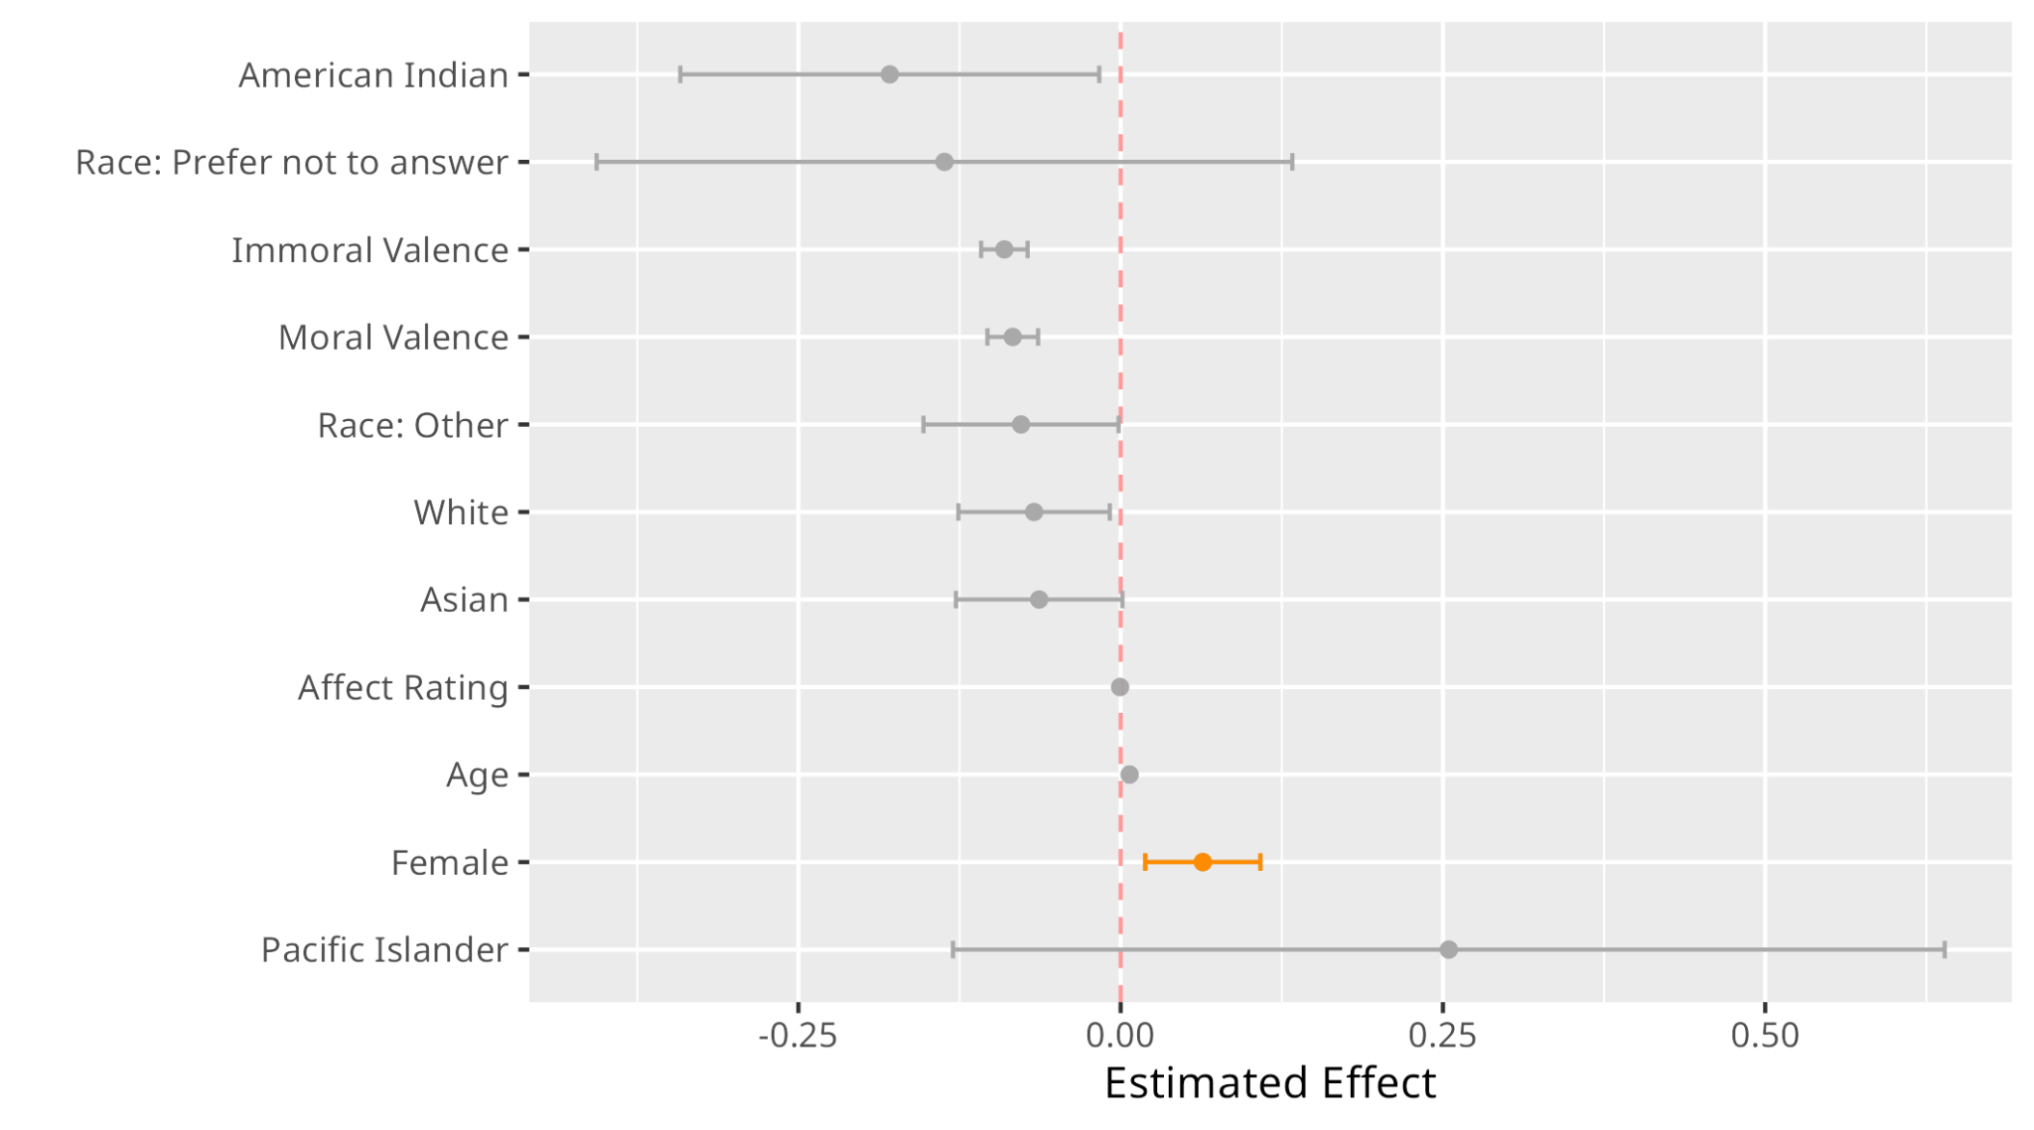

Slide 104
Linear Mixed Effects Models: Implicit (Images)
Birth Gender
Age
Movement
Moral Valence
Fixed Effects
Intercept: Participant
Random Effects
Notes:
Explain random effect choices

Slide 105
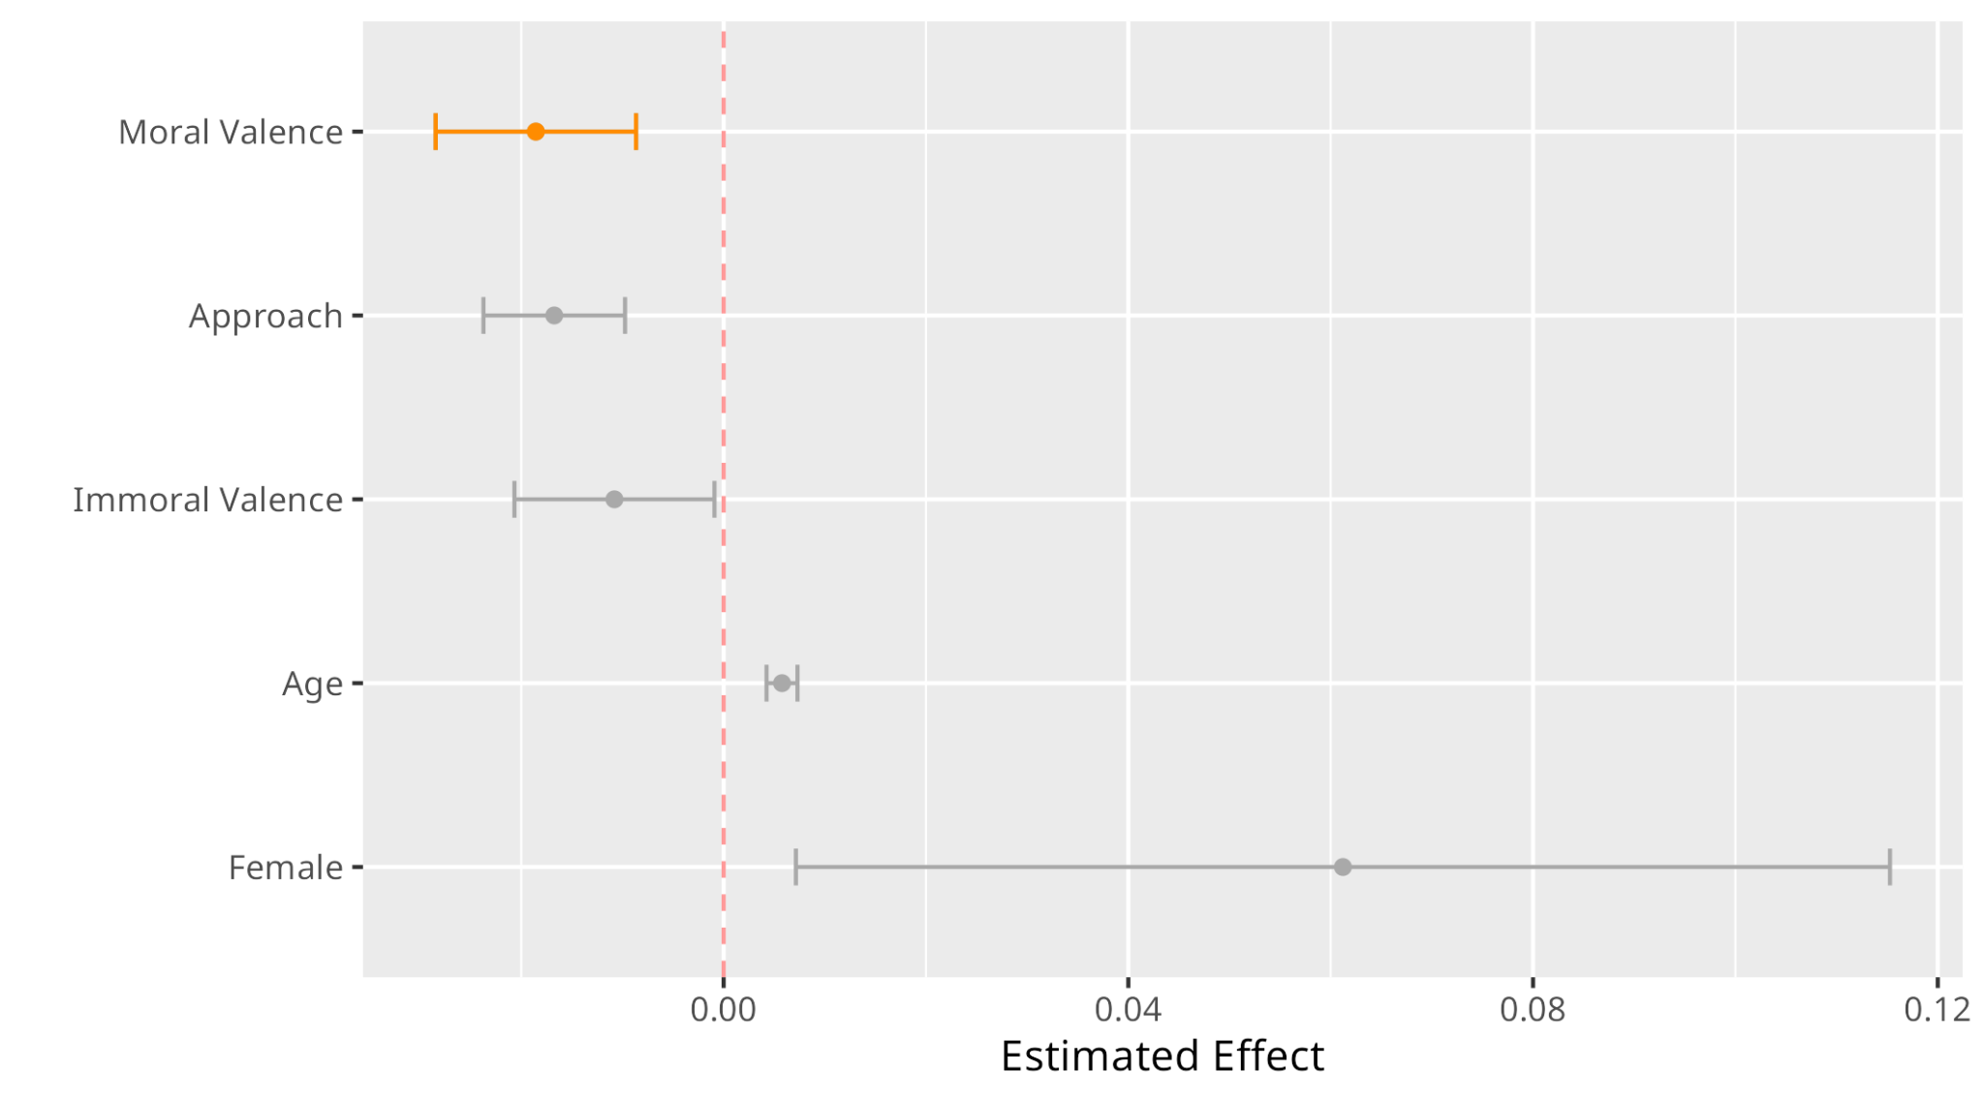
On average, compared to Neutral-rated phrases, responses to Moral-rated phrases are faster by 1.9%.
Notes:
Baseline: Neutral Valence, Avoid, Male

Slide 106
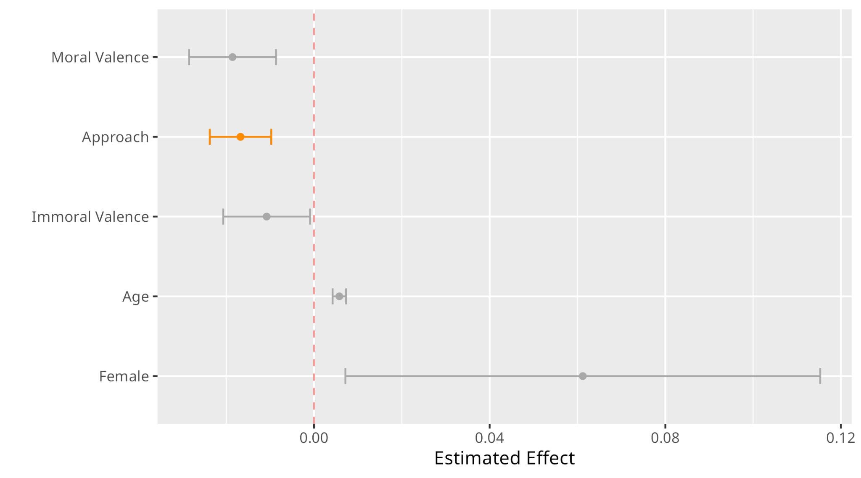
Approaching is faster than avoiding by approximately 1.6% (a faster compared to phrases)

Slide 107

On average, compared to Neutral-rated phrases, responses to Immoral-rated phrases are faster by 1%.

Slide 108
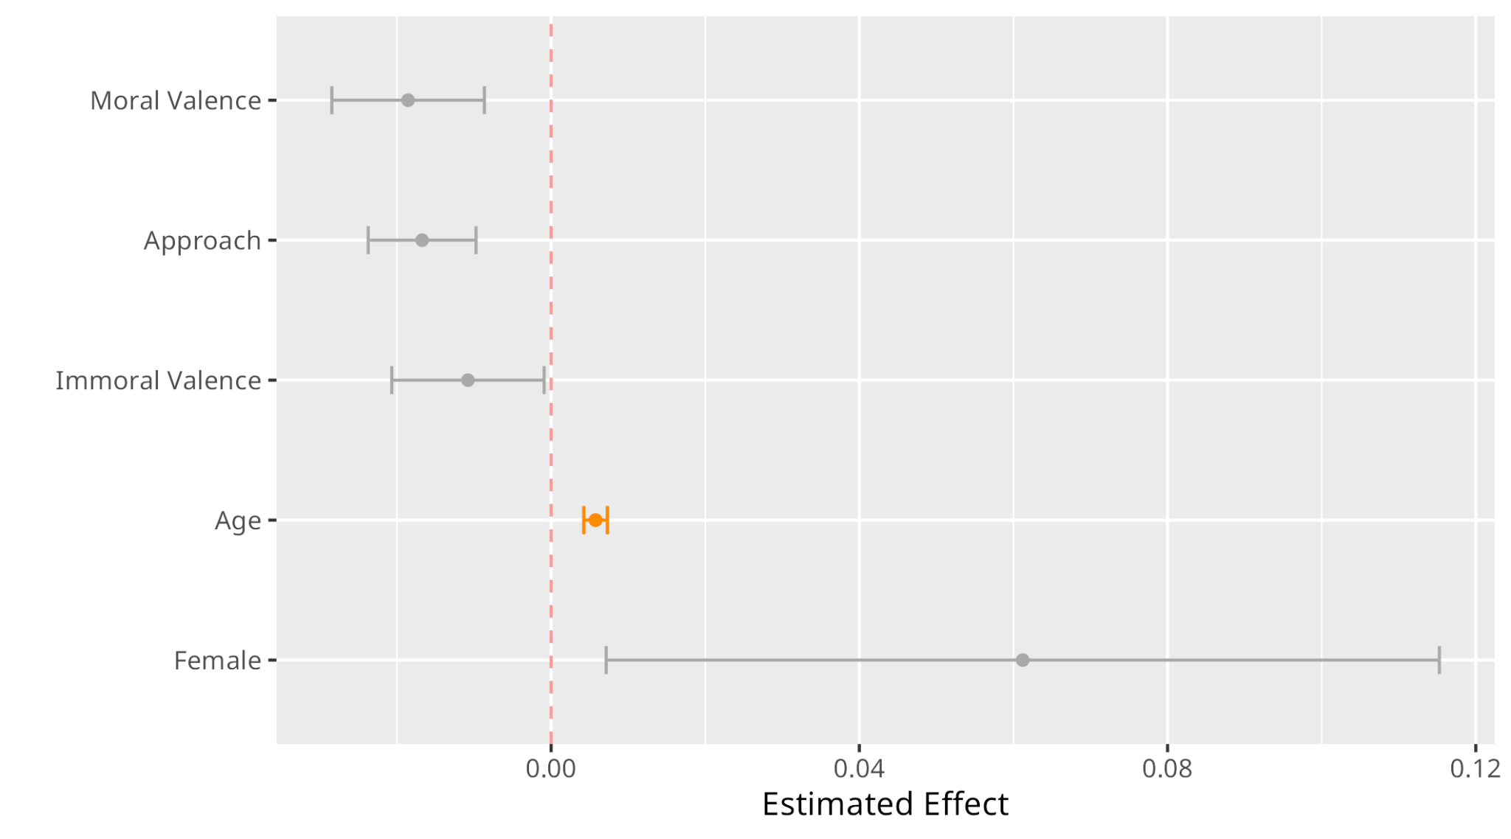

Slide 109
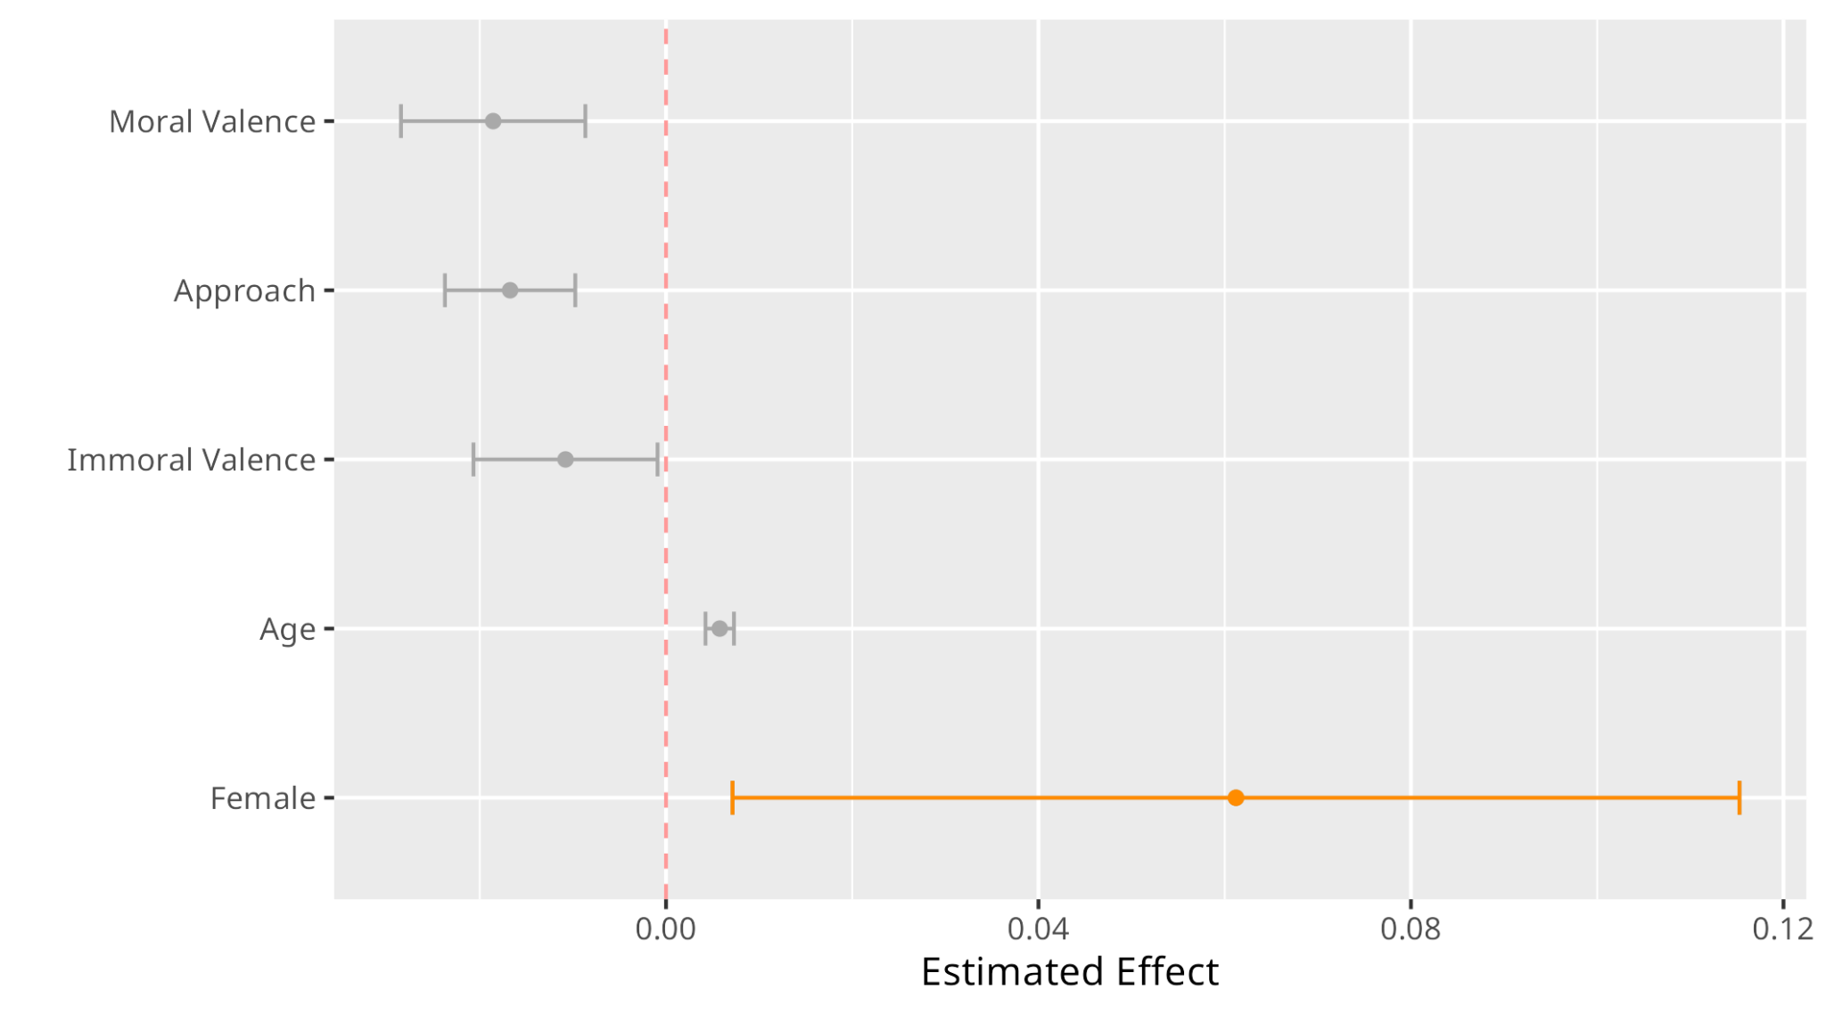

Slide 110
Linear Mixed Effects Models: Explicit (Images)
Age
Moral Valence
Fixed Effects
Intercept: Participant
Slope: Moral Valence
Random Effects
Notes:
Explain random effect choices

Slide 111
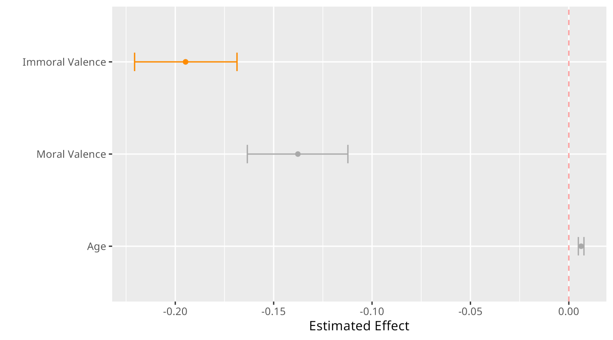
On average, compared to Neutral-rated phrases, responses to Immoral-rated phrases are faster by 17.3%.
Notes:
Baseline: Neutral Valence

Slide 112
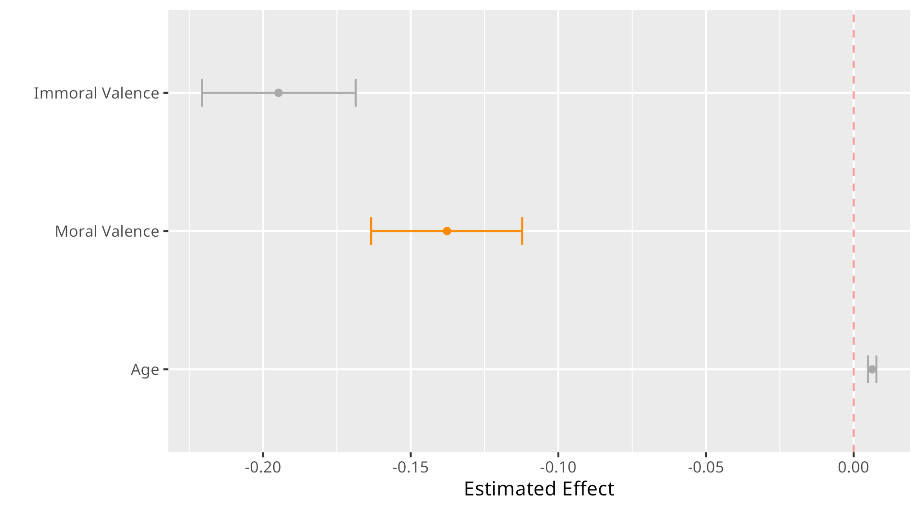
On average, compared to Neutral-rated phrases, responses to Moral-rated phrases are faster by 12.9%.

Slide 113
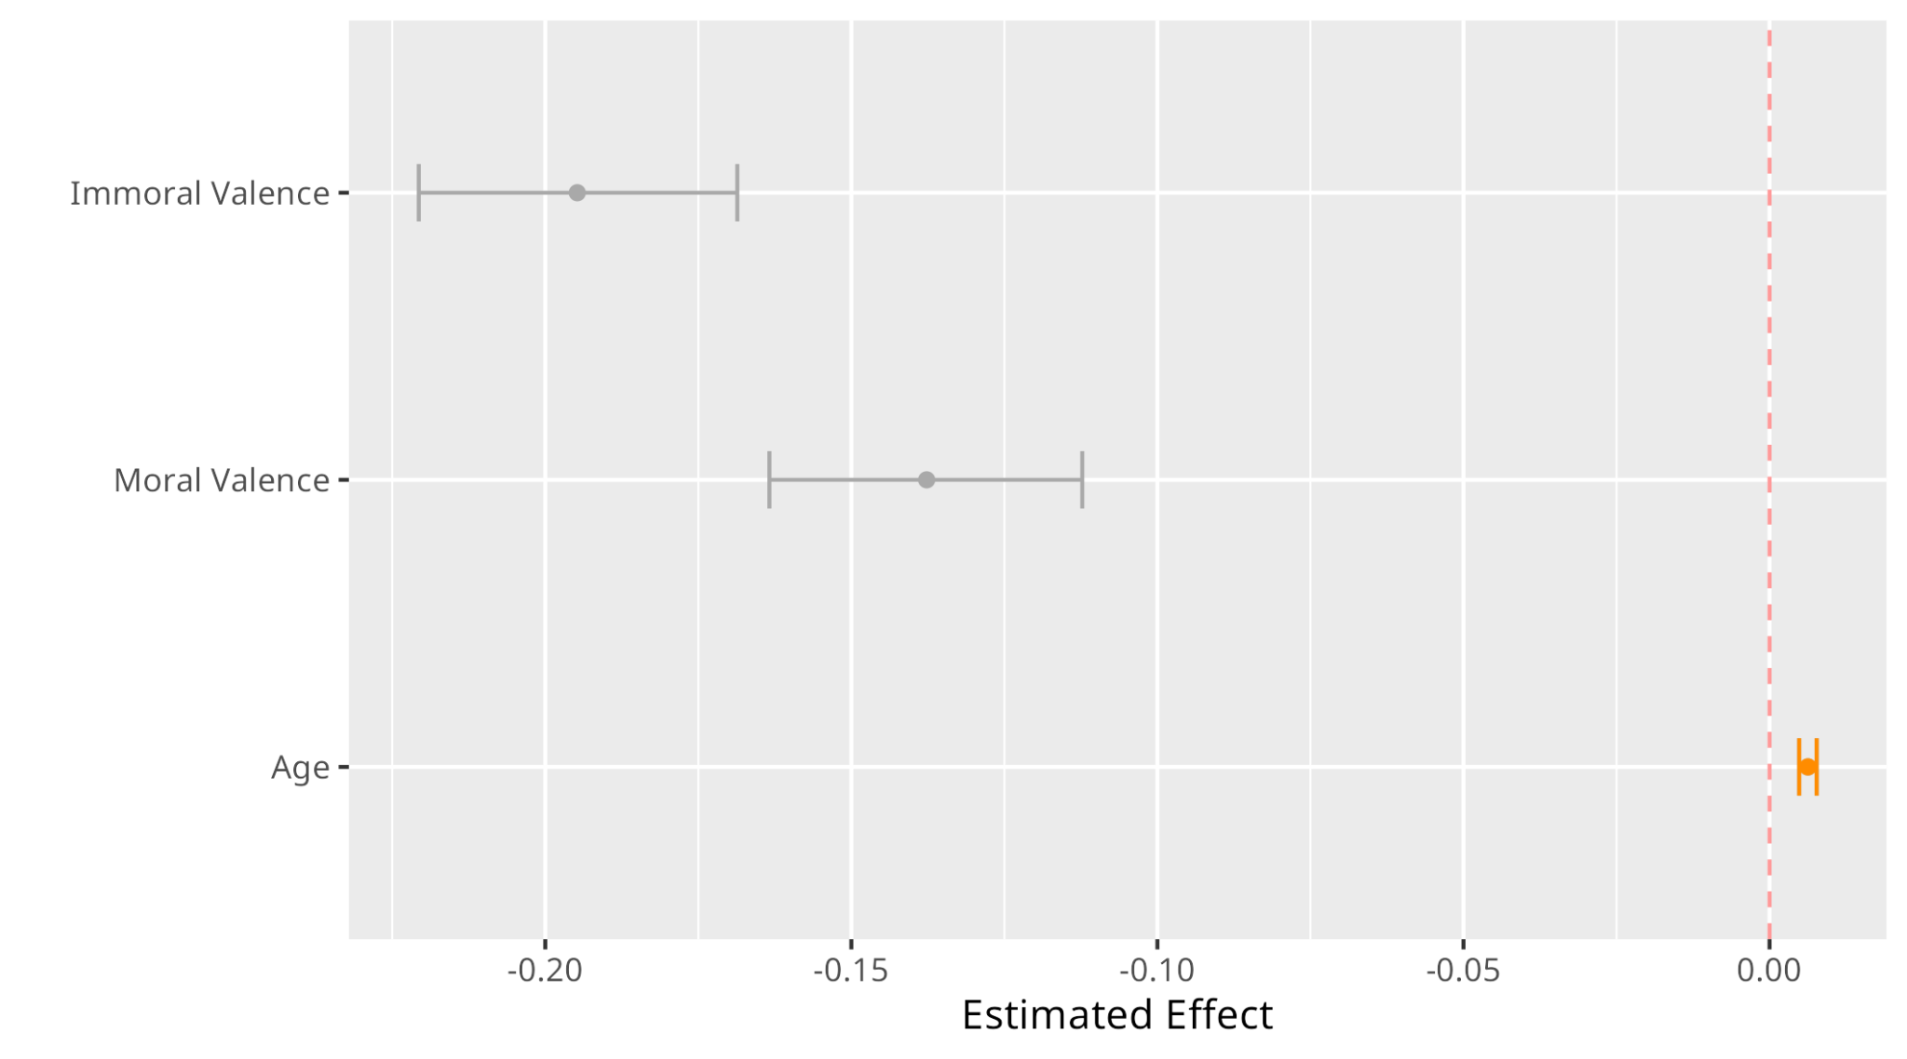

Slide 114
There might be a relationship, but is it predictive?:
Supervised ML Prediction of Response Time

Slide 115
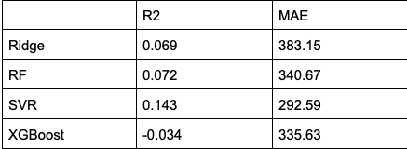
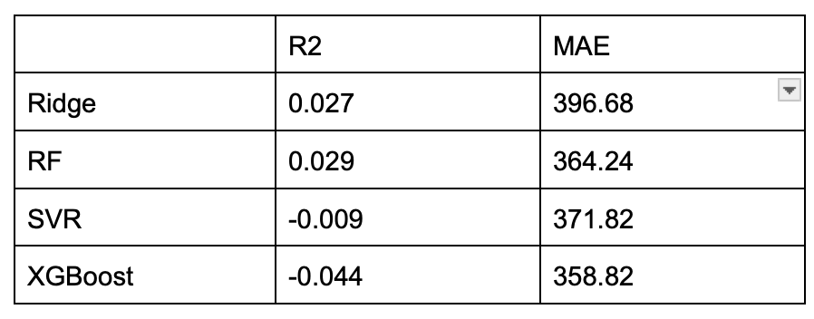
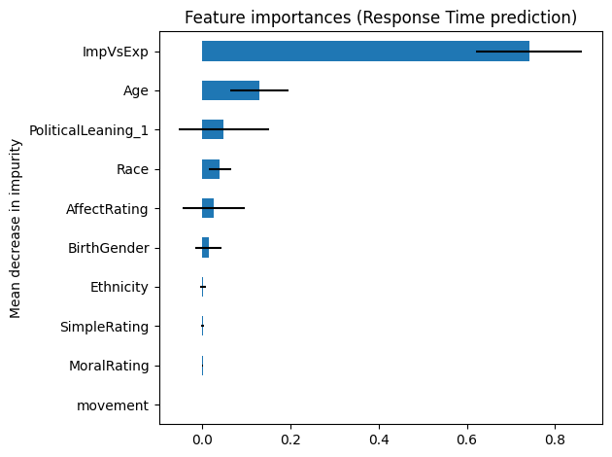
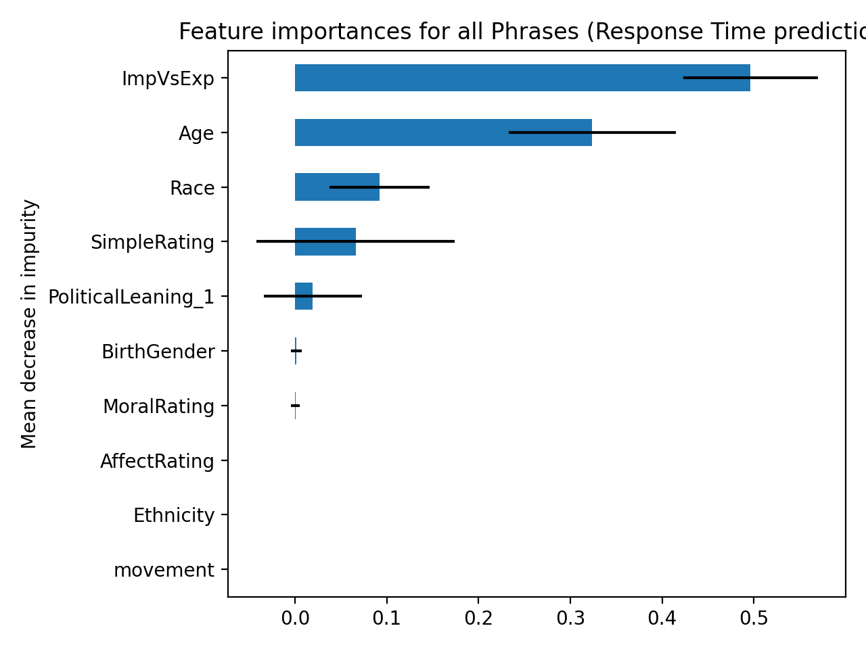
Performance is Poor (particularly for images) and Moral Rating Does Little to Nothing in Predicting Response Time
Notes:
Svr seems like the model that is worth optimizing to see how well we can actually predict response time for both aggregate and when evaluation type is split
Age, race, and political identity are consistent in offering the greatest weight to predict response time once you get past the lion’s share of the variance being accounted for by the difference in implicit vs explicit (implicit is just much faster than explicit so it is the split in the data that separates response times most thoroughly)

Slide 116
Are these the ‘right’ stimuli?:
Unsupervised ML Validation

Slide 117
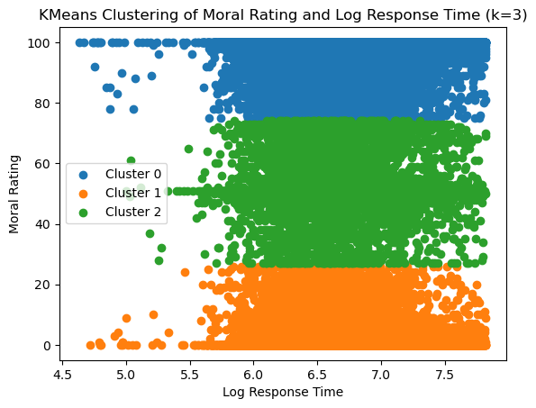
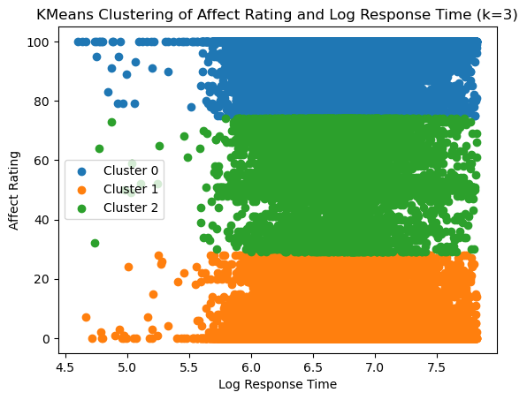
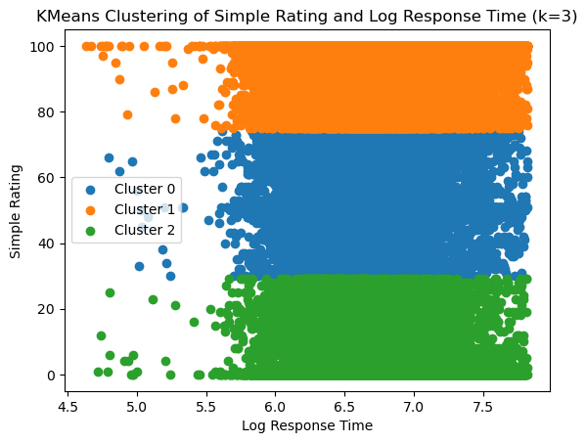
Morally Good = the most pleasant and medium complex
Morally Bad = the least pleasant and least complex

Slide 118
Next Steps: MAAT Study 1
Optimize machine learning approaches
Supervised: Predict specific stimuli, moral category of stimuli
Unsupervised: More models to improve clustering
Develop a simulation-based power analysis
Examine asymmetries/differences in inferential and predictive relationships
Compare participant-assigned moral valence to our assigned moral valence
Notes:
Prediction with supervised ML: Predict 1) Specific Stimuli and 2) Moral Category of Stimuli // Unsupervised ML: use other models, potentially use other versions of K-means more suitable for categorical data (K- Modes, Mixed Clustering)

